Slide 1
Relativistic Kinetic Shear Flows:
Field Generation, Particle
Energization and Radiation
Edison Liang, Rice University
Collaborators: Wen Fu, Jake Spisak, Markus Boettcher,
Ian Smith, Parisa Roustazadeh
Work supported by NASA, NSF

Slide 2
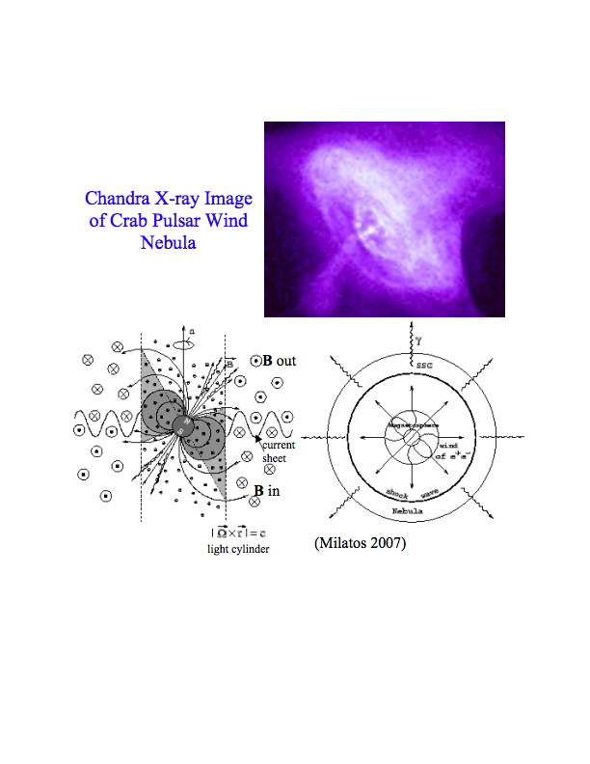
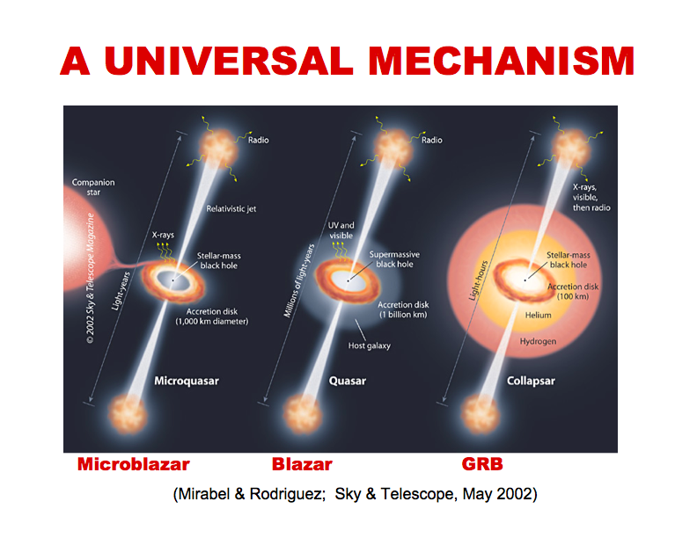
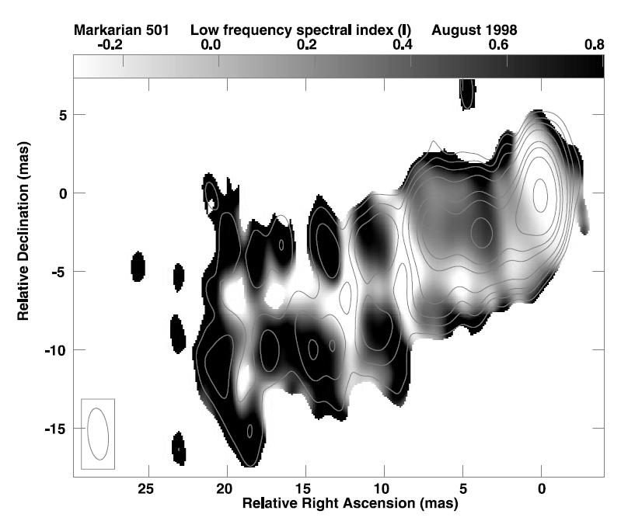
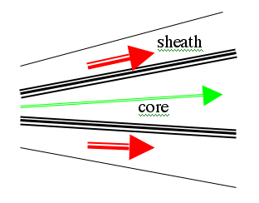
Relativistic shear boundary layer (SBL) likely
ubiquitous in many astrophysical outflows
Pulsar wind
Limb-brightening of many radio galaxies in VLBI observations consistent with boundary layer emission of spine-sheath jets
(from Giroletti et al. 2004).
Low-Γ
High-Γ
enhanced synchrotron emission
requires strong B-field and
nonthermal particle acceleration
Low-Γ

Slide 3
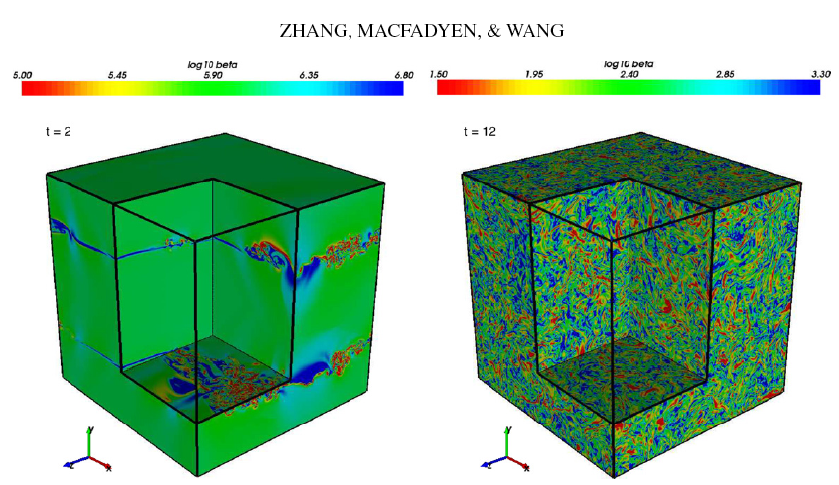
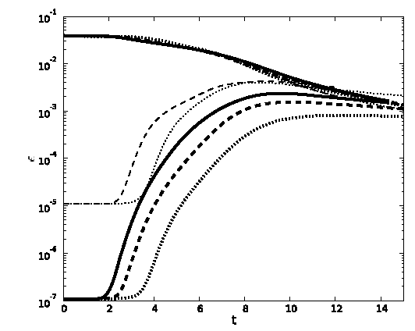
Hydro KHI
MHD KHI
Fluid simulation amplifies
seed B field via KHI turbulence,
but only up to e_{B}~5x10⁻³,
cannot create ordered
Macroscopic fields.
Shear Flow Free Energy is
thermalized via turbulence
cascade
5x10⁻³
E_{em}/E_{kin}

Slide 4
.
PIC simulations of relativistic shear flows are performed in
the Center of Momentum (CM) frame so that Γ = 2p_{o}²+1
B_{o}=0 kT=2.5 keV n=1
m_{i}/m_{e}=1, 1836, p_{o}=15
20-40 particles/cell
yω_{e}/c
2048-
12288
p_{x}=-p_{o}
X
1536
0
p_{x}=+p_{o}
512
Transverse
plane (T)
p_{x}= -p_{o}
xω_{e}/c
1024
zω_{e}/c
Momentum-plane (P)
1024

Slide 5
We studied 4 Types of Relativistic Shear Flows:
100 % e+e- plasma m_{i}=m_{e}
100% e-ion plasma m_{i}=1836m_{e}
Uniform Hybrid: 90% e-ion, 10% e+e- plasma
4. e+e- spine sandwiched by e-ion sheath
PIC Codes used: 2D ZOHAR (LLNL)
& 3D EPOCH (UK)

Slide 6
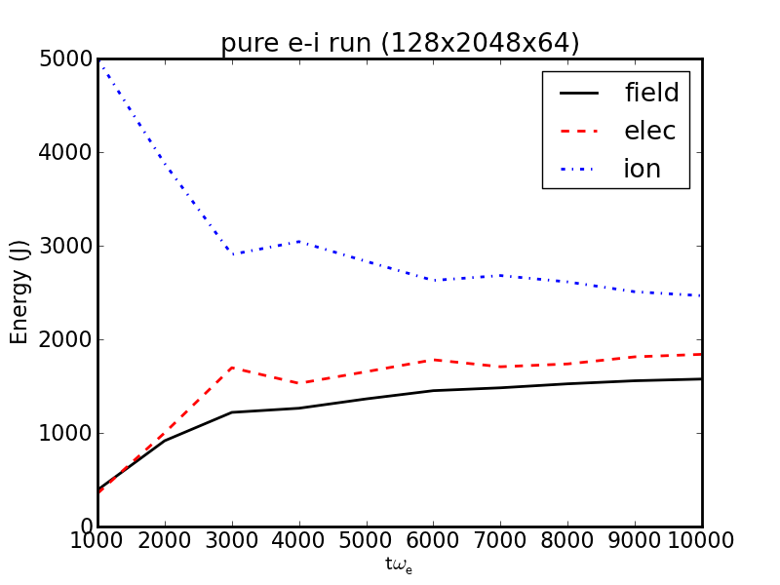
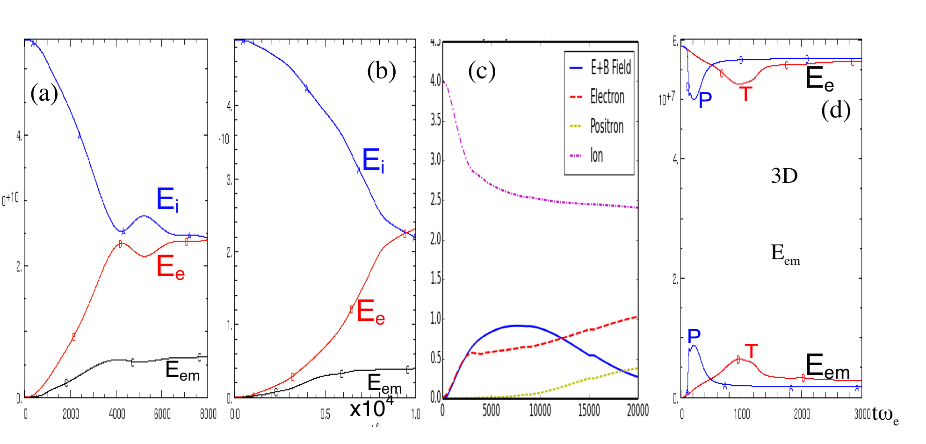
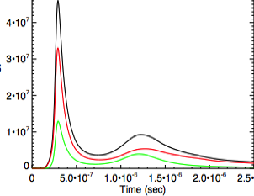
electrons/leptons achieve energy equipartition with ions
on time scale proportional to size of y-grid
100%e-ion 90%e-i,10%e+e- e+e-/e-ion sandwich 100%e+e-
3D
E_{em}
3D
E_{em}
E_{em} saturates at ~ 8-12% of total energy except in (c)
where it drops to ~ 4%

Slide 7
ECCI growth goes through multiple stages. P-mode
dominates in late stages, whose saturated dc fields
completely dominate late-time particle energization
P
T
T
P
2D P-mode results are good approximations
of 3D results in global features and particle energetics

Slide 8
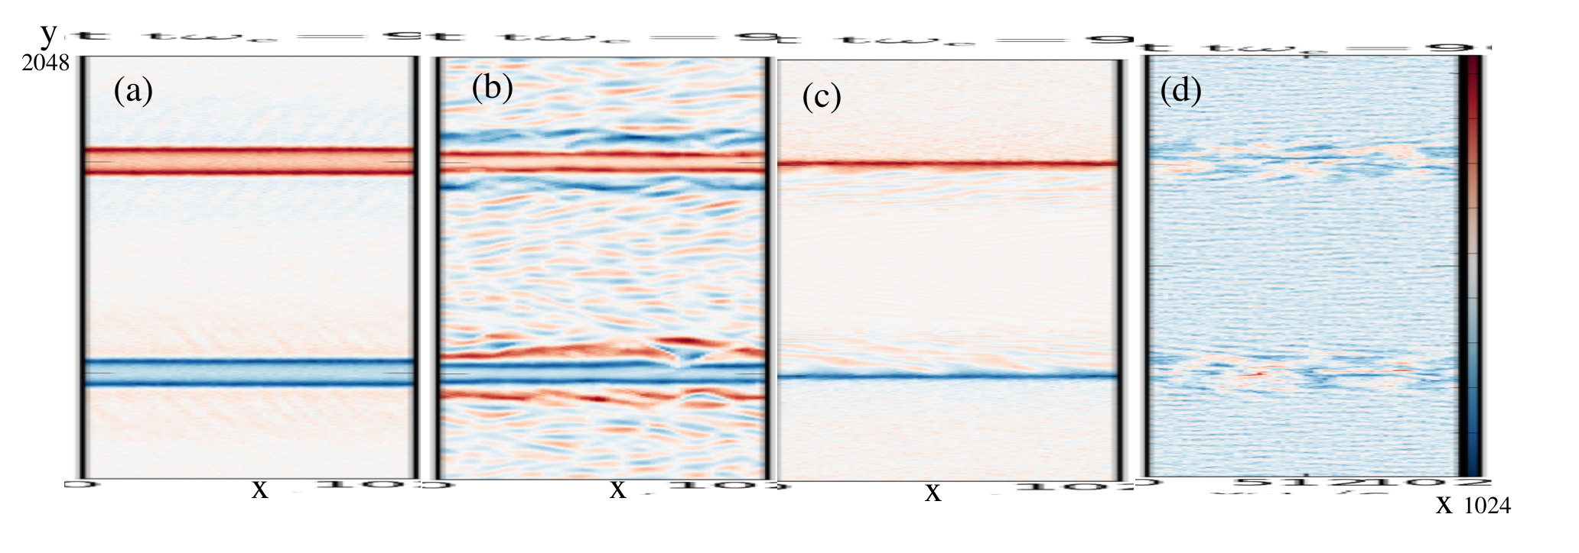
B_{z} profile contour plots for p_{o}=15
e-ion
100%
e-ion
90% e-ion
10% e+e-
100%
e+e-
e+e-

Slide 9
In ion-dominated shear boundary, transverse fields are
generated by electron counter-current instability (ECCI)
j_{ion}
j_{e}
J_{net}
B_{in}
monopolar layer of d.c. slab field is generated
along the entire shear interface

Slide 10
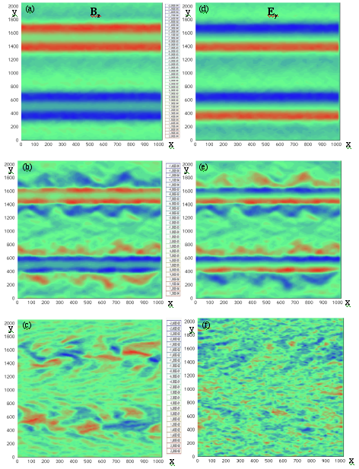
p_{o}=15
P-mode
dominates in
all Ion runs
100% e-ion
In 3D runs,
oblique modes
generate
additional (B_{y},E_{z})
but they saturate
at amplitudes
<< (B_{z}, E_{y})
tω_{e}=3000
90% e-ion 10%e+e-
100% e+e-

Slide 11
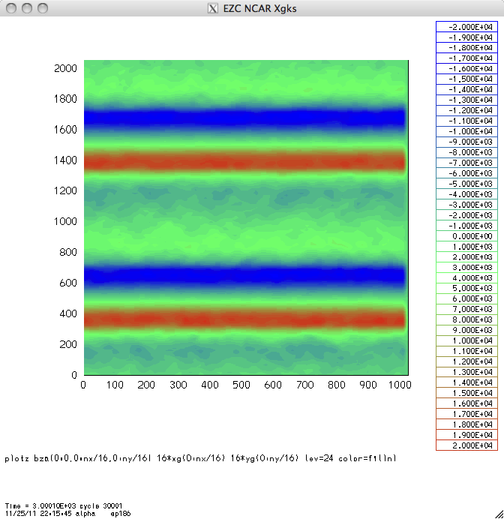
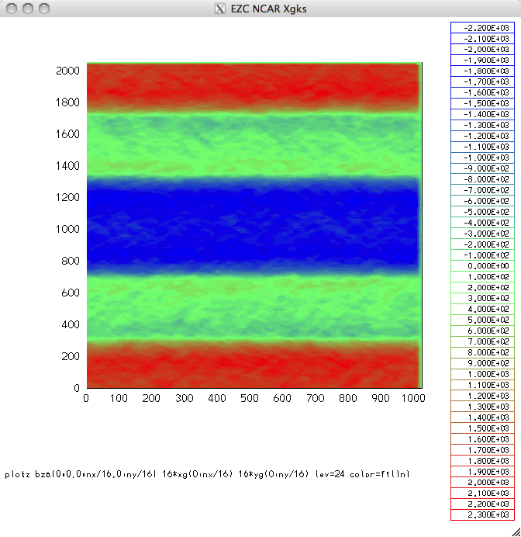
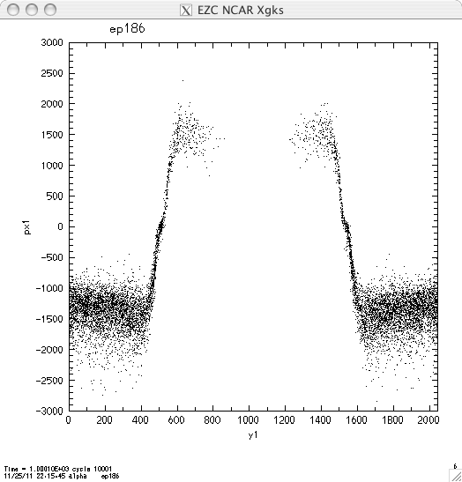
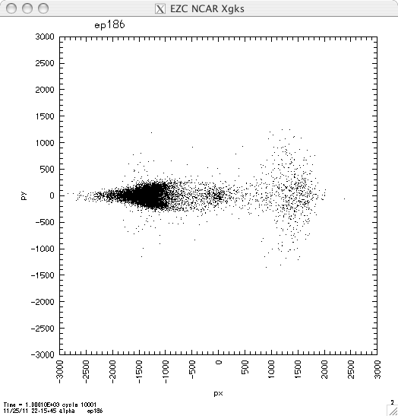
E_{y}
E_{x}
p_{x}
p_{y}
p_{o}=15
tω_{e}=2000
p_{x}
y

Slide 12
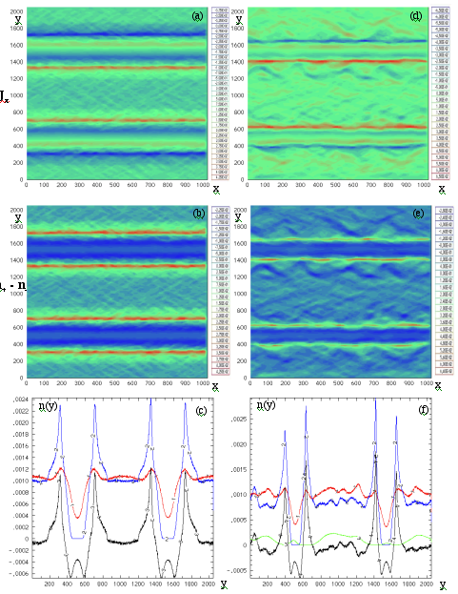
J_{x}
p_{o}=15mc
pure e-ion
90% e-ion 10% e+e-
tω_{e}=3000
n₊-n₋
Ion
vacuum
gap
persists
indefinitely
ion
e-
n₊-n₋

Slide 13
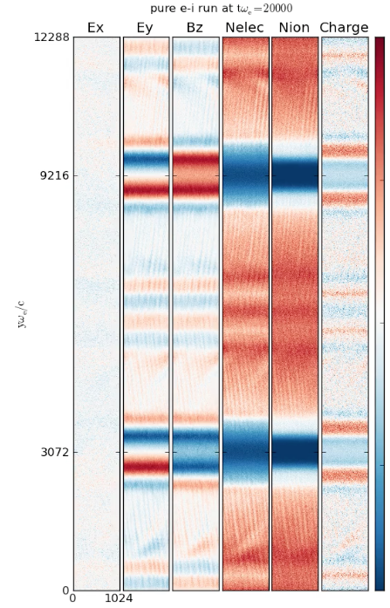
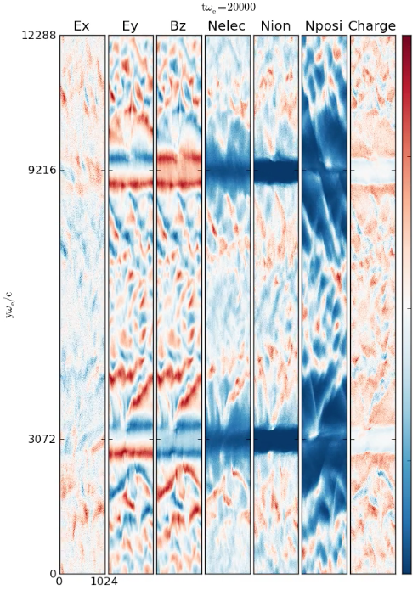
vacuum gap which separates the opposing flows remains robust
and stable for long times, sustained by strong d.c. fields
hybrid 90/10

Slide 14
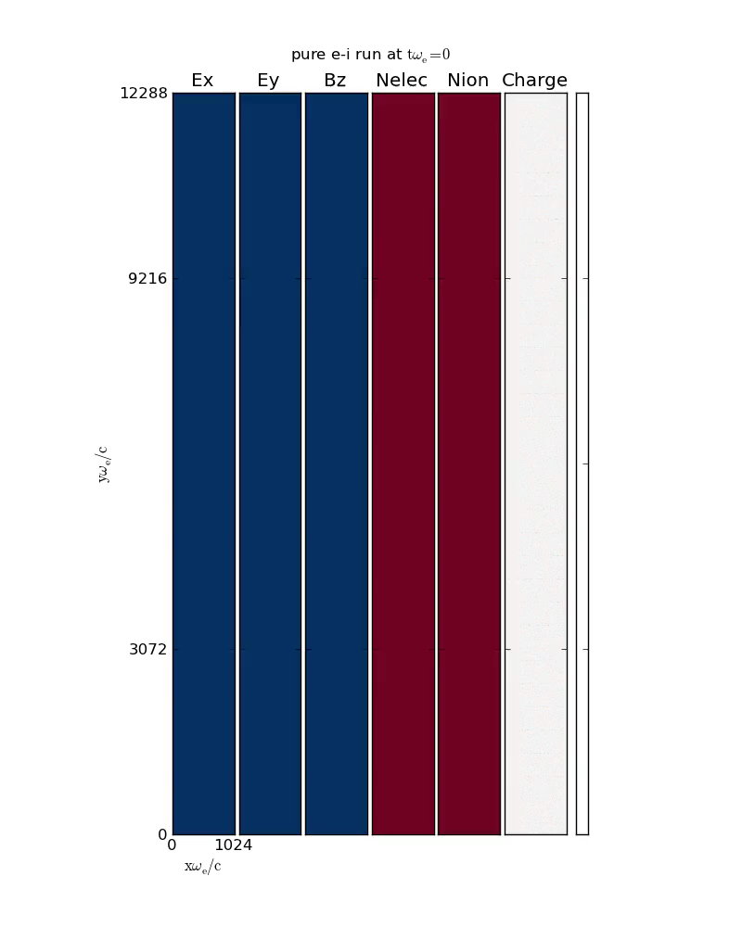
100% e-i

Slide 15
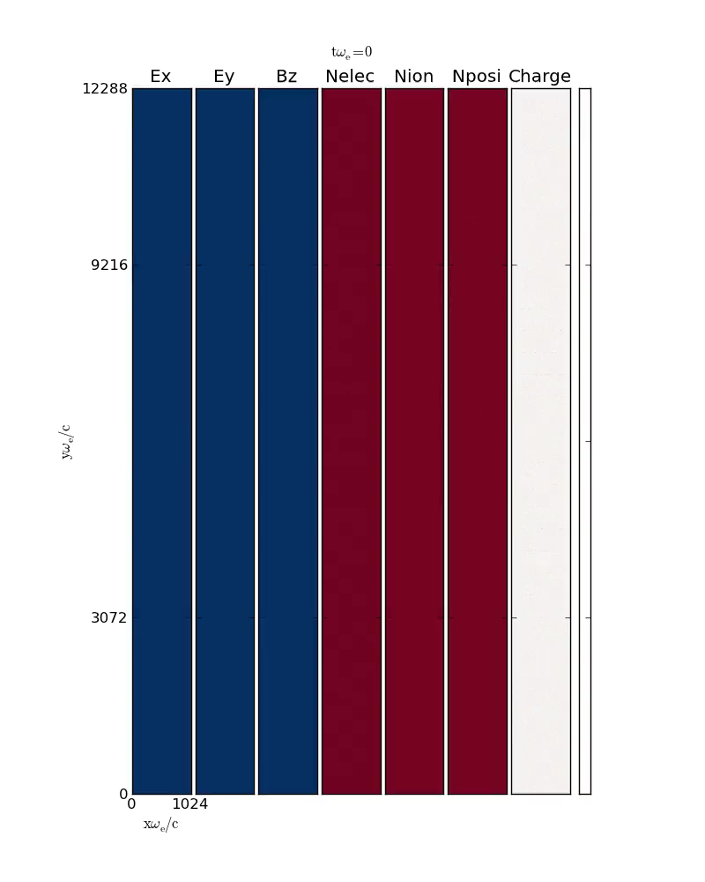
90% e-I
10% e+e-

Slide 16
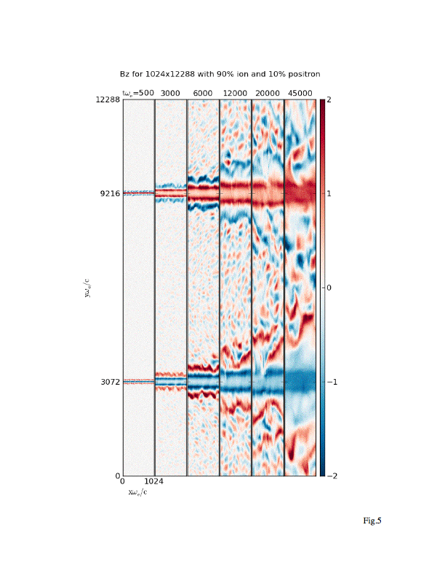
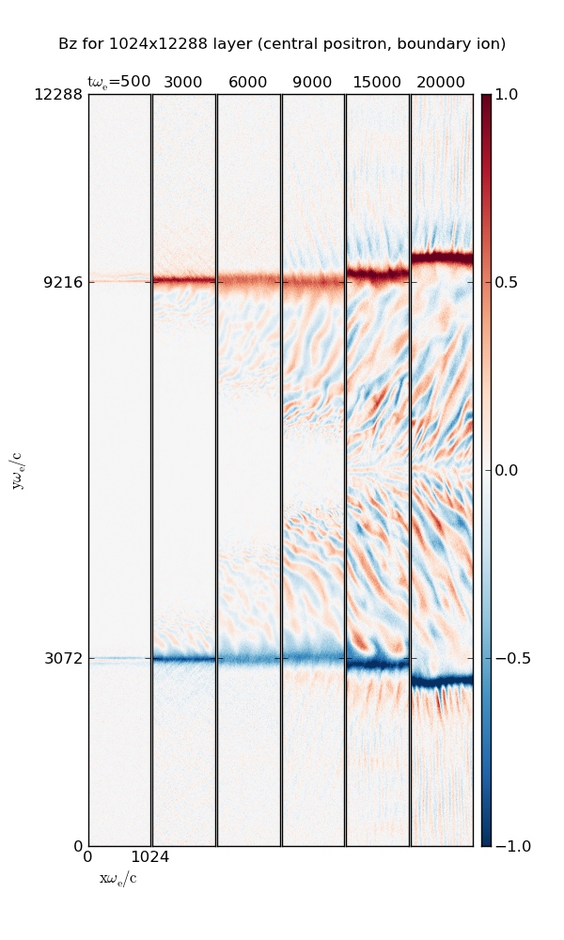
90/10 hybrid SBL thickness saturates at ~1000 skin depths but the EM turbulence
outside the SBL continues to expand into rest of flow.
Sandwiched hybrid SBL stays thin, but the EM turbulence mainly grows on the e+e-
side in the form of long narrow oblique filaments.

Slide 17
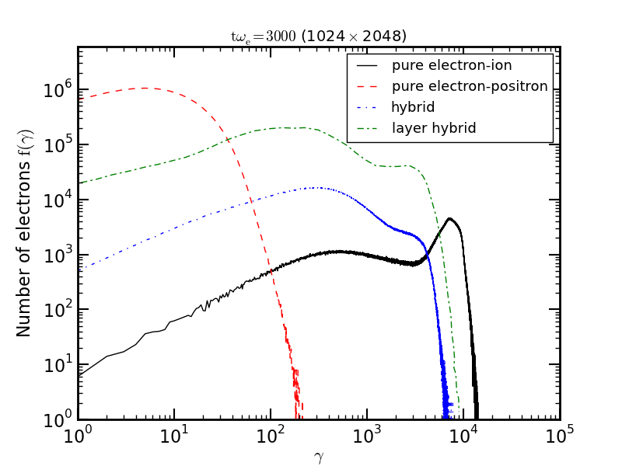
only hybrid e+e-ion shear flows develop power laws
100% e+e- produce peak energy too low to explain blazar & GRB
γ_{e}=m_{i}p_{i}/m_{e}

Slide 18
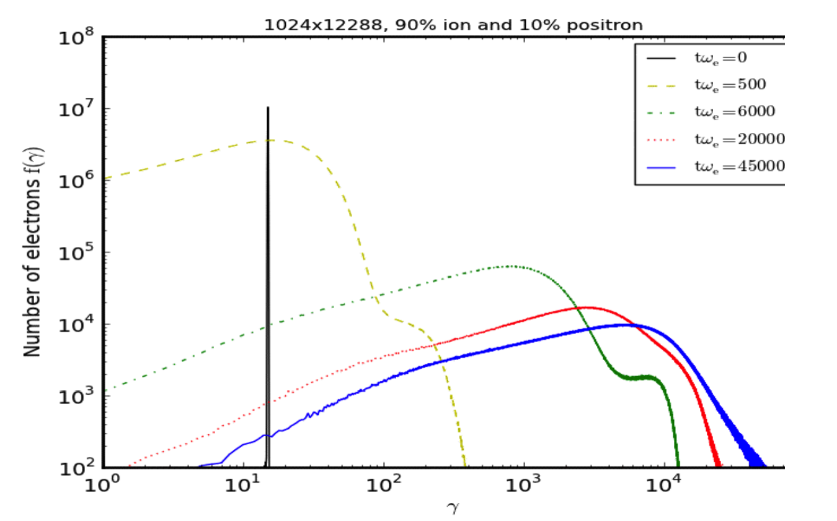
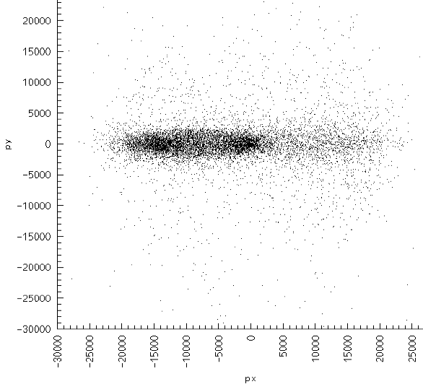
In hybrid e+e-ion case, -3 slope power law forms at late times
corresponding to emitted photon index = 2.
All runs show strong momentum anisotropy
ε_{e}~p_{i}m_{i}
-3
50GeV

Slide 19
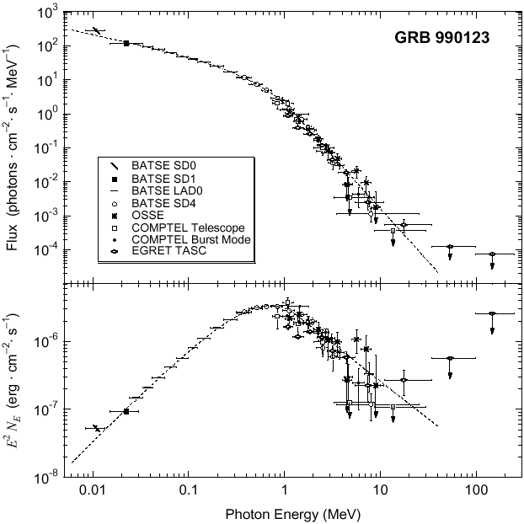
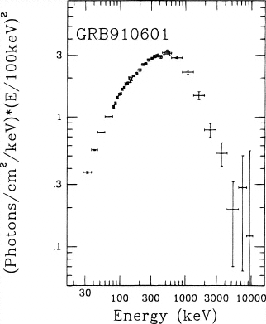
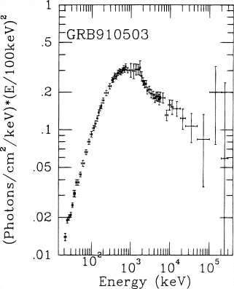
Observed Spectra of GRBs
⇑
⇑
E_{pk}
E_{pk}
Band Function
Schaefer et al. (1998)
Observed GRB spectra strongly resemble
hybrid SBL synchrotron spectra.
Predicted critical frequency appears consistent with
observed E_{pk} values

Slide 20
1000
comparison
of p_{o}=5
vs p_{o}=15
runs
3000
12000

Slide 21
global E_{x} fields
responsible for
e- acceleration
until they reach
ion energy, after
which E_{x} fields
decay.

Slide 22
In lab frame, most spine electrons are accelerated to ion drift
energy, but some diffuse to sheath side and are decelerated
y p_{o}=5 y p_{o}=15
p_{xLab} p_{xLab}

Slide 23
In lab frame, energetic electrons are narrowly beamed
p_{y} p_{o}=5 p_{y} p_{o}=15
p_{xLab} p_{xLab}
log|p_{y}/p_{xLab}| p_{o}=5 log|p_{y}/p_{xLab}| p_{o}=15
γ_{Lab} γ_{Lab}

Slide 24
electrons in trapped orbits radiate the most energy at bounces
e -
ion
+
E
-
ion
+
E
e -

Slide 25
Extrapolate y-profiles to + / - infinity to model single SBL
Bz
Ex
y
Ey

Slide 26
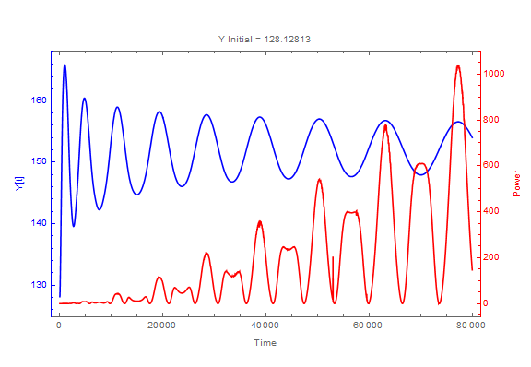
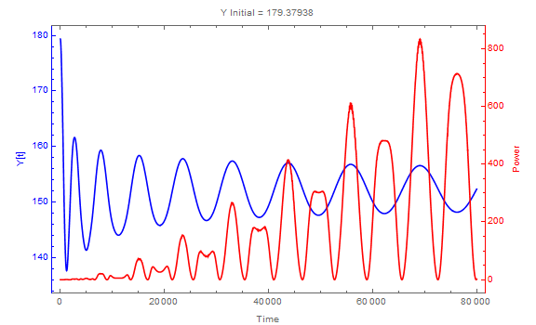
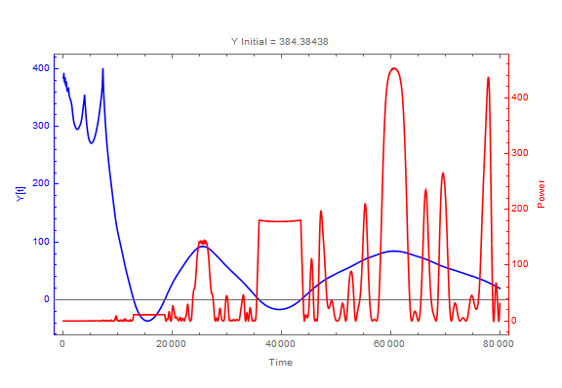
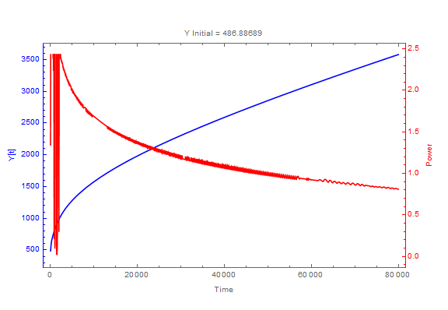
Trapped electrons radiate the most power

Slide 27
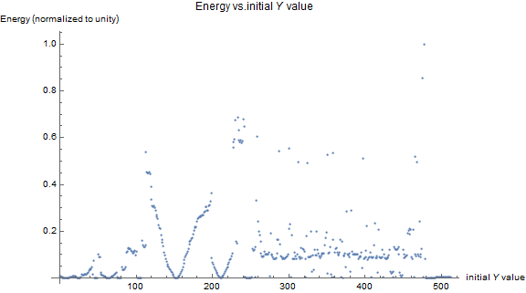
electrons initially at y=100 to 300 just outside the slab field layer
radiate the most energy

Slide 29
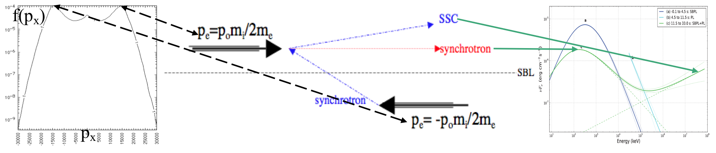
enhanced inverse Compton emission is expected along shear
boundary due to the two opposite high-γ electron streams
SSC may be important to blazar and GRB emissions
when viewed along the shear boundary

Slide 30
Optically Thin Synchrotron (OTS) Model of GRB
E_{pk}~ p_{o}(ε_{pk}/m_{e}c²)²hν_{e}/(1+z), where ν_{e} = eB/2πmc
ε_{pk}~p_{o}m_{i}c²f/2, f=ion fraction.
For example:
If Γ =2p_{o}²= 450, f = 0.9, z = 1 and
E_{pk} = 250 keV (Preece et al 2000), we obtain
B (in the CM frame) ~2x10⁴ G.
Using B²/4πp_{o}nm_{i}c²~8%, we obtain ion (~electron)
density n (in the CM frame) ~10¹⁰/cm³.
These #s are ~consistent with current observational constraints.

Slide 31
Application to Blazars
For typical bulk Lorentz factor Γ ~ 10,
the shear boundary energization scenario predicts
synchrotron peaks in the IR-optical and EC gamma-ray
peaks up to the GeV regime, as observed in
LSP blazars , along with SSC-dominated
hard X-ray and soft gamma-ray emission, peaking around
~ few MeV.
However, applying this scenario to high-frequency-peaked
BL Lac objects (HBLs) with observed synchrotron peak
frequencies of n ~ 10¹⁷ Hz would require bulk Lorentz
Factors Γ >>10 inferred for blazars in general, unless the
magnetic field in the CM frame is >> Gauss.

Slide 32
Summary and Conclusions
PIC simulations show efficient ordered EM field creation
and nonthermal particle energization at relativistic SBL.
3. Ion-dominated SBL generate monopolar slab of d.c.
field. Ion vacuum gap created at the SBL inhibits
turbulent mixing and sustains opposing laminar flows.
4. Electrons are energized to ~ ion kinetic energy
but no power-law tail in pure e-ion flows.
Hybrid e+e-ion SBL generates monopolar d.c. fields
plus EM waves. Hybrid SBL accelerates nonthermal
electron to form hard power-law tail out to >
10’s of GeV.
Highest energy electrons may radiate coherent radiation
with broad spectrum and rapid variability.
8. SBL Radiation can be more narrowly beamed than 1/Γ

Slide 33
B_{k}
log(B_{k}²)
ky
ky
kx
kx
B_{kx(y512)}
kx

Slide 34
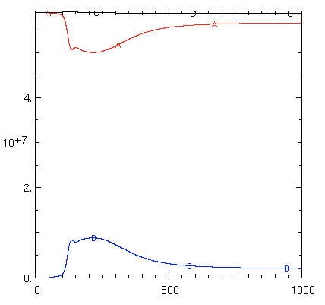
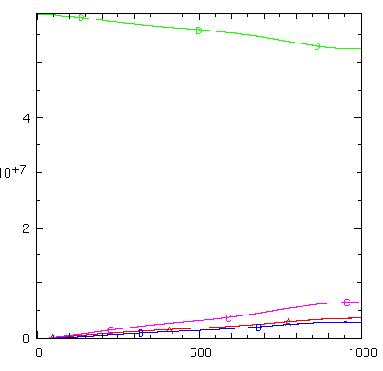
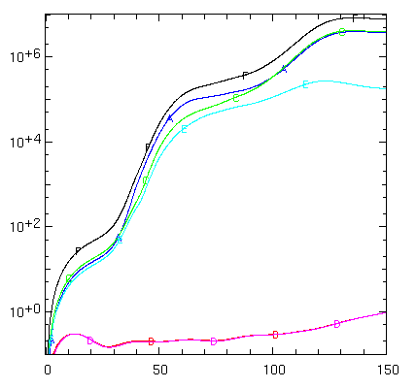
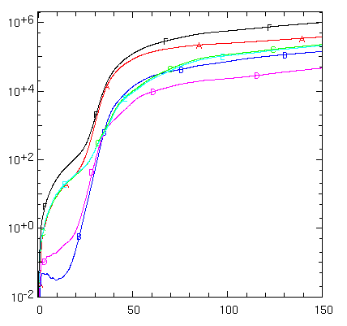
In pure e+e- case, linear growth of transverse
EM fields is consistent with
oblique Weibel modes due to interface-crossing
streaming instabilities
P-mode (x,y) only
T-mode (y,z) only
E_{particle}
E_{pariticle}
E_{field}
E_{field}
tω_{e}
tω_{e}

Slide 35
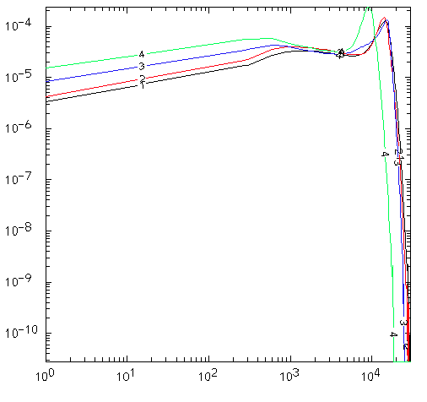
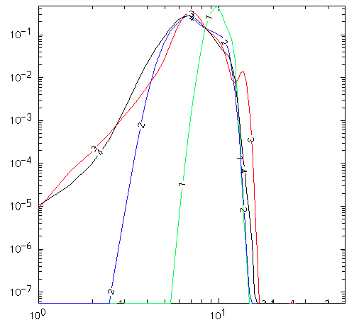
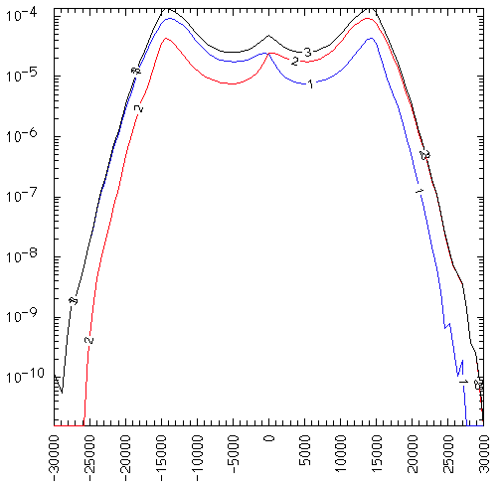
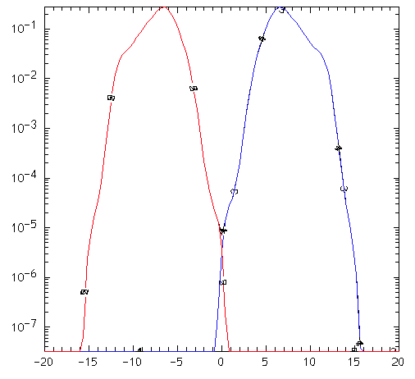
100% e-ion, Evolution of fe, fi
f_{e}(γ)
f_{i}(γ)
p_{o}=15
γ
tω_{e}=8000
f_{e}(p_{x})
f_{i}(p_{x})
p_{x}

