Slide 1
From Megagauss Jets to Gamma-Ray Bursts: New Frontiers in HED Laboratory Astrophysics
Edison Liang, Rice University
γ
Work supported by DOE

Slide 2
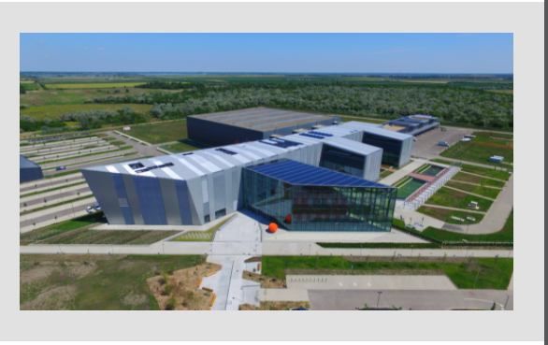
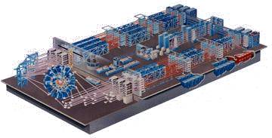
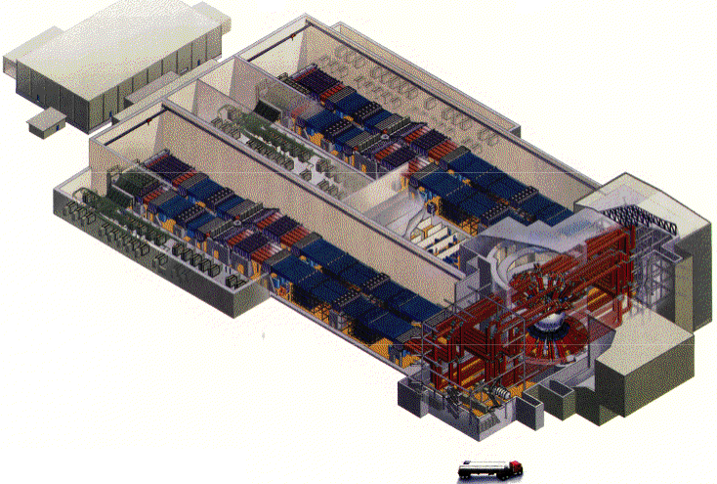
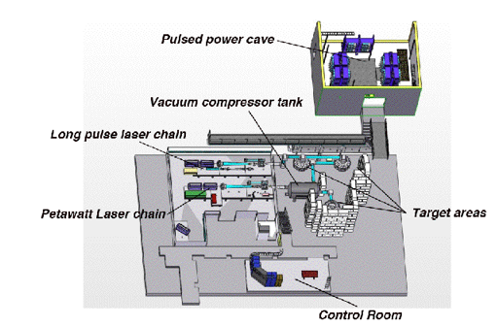
HEDP facilities are proliferating
in the US, Europe and Asia
Omega laser facility,
Univ. of Rochester
Omega laser
ELI
TPW
The National Ignition Facility
LLNL

Slide 3
Two Frontiers of High Energy Density Physics (HEDP)
(energy density > 10⁵ J/cm³, pressure > 1 Mbar)
Energy Frontier (NNSA): compress matter to extreme conditions
similar to those at the center of stars, using ~ ns “long-pulse”
multi-beam (kJ-MJ) lasers (NIF, LMJ) or pulse power machines (Z)
2. Intensity Frontier (OFES): create high-energy beams of e-, e+, ions,
γ, using ~ fs “short-pulse” PW lasers (TPW, ELI) focused to the
diffraction limit to achieve relativistic intensity > 10¹⁹ W/cm².

Slide 4
Two HEDP experiments led by our group:
Project A falls under the Energy Frontier,
Project B falls under the Intensity Frontier.
A. Use multi-beam kJ lasers to create strongly magnetized jets and collide them to form magnetized shocks
B. Use PW laser to create dense e+e- pair plasmas and ultra-intense gamma-ray beams
Both experiments are motivated by astrophysics, but have
many other applications.

Slide 5






Project A uses the Omega Laser at LLE, Rochester, NY
Goals: To study the formation, structure and evolution of strongly magnetized shocks formed by the head-on collision of two megagauss plasma jets created by hollow rings of laser beams.
E. Liang¹, L. Gao², Y. Lu¹, J. White¹, B. Cage¹, R. Follet³, H. Sio⁴, P. Tzeferacos⁵, D. Froula³, A. Birkel⁴, C. Li⁴, R. Petrasso⁴, W. Fu¹, L. Han¹, D. Lamb⁵, M. Wei³ , , A. Chien², S. Zhang², H. Ji², H. Li ⁶
¹Rice University, Houston (PI)
²Princeton Plasma Physics Laboratory, Princeton
³Laboratory for Laser Energetics, Rochester
⁴Massachusetts Institute of Technology, Cambridge
⁵University of Chicago, Chicago
⁶LANL
Supported by DOE NNSA NLUF

Slide 6
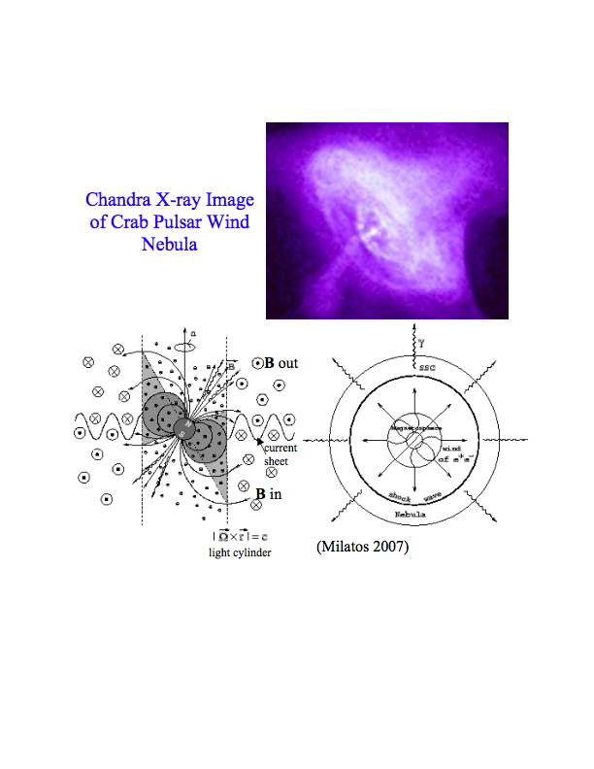
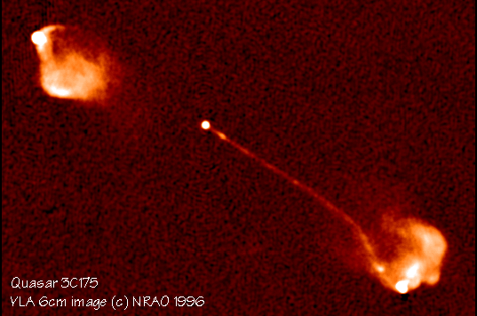
Observations suggest many astrophysical jets may be strongly magnetized
However, in laser created outflows, B field decays rapidly
BB
B ~ 0
MG B
divergent outflow

Slide 7
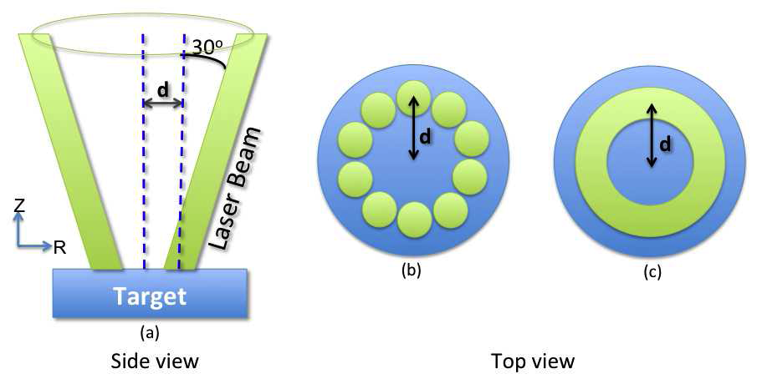
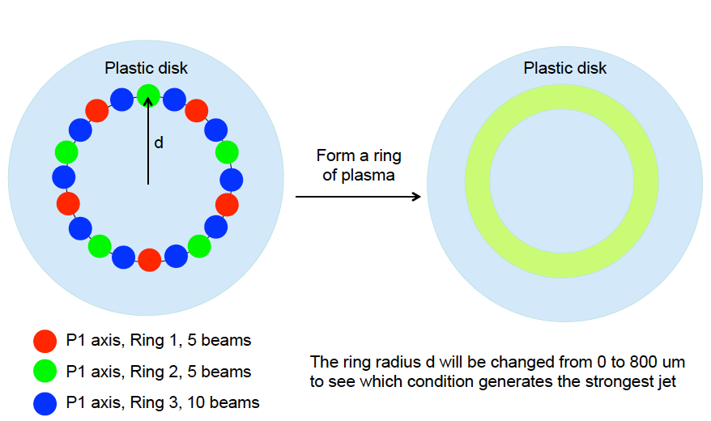
Motivation : How to create collimated strong-B outflow far from laser target ?
2015-16 Experiments used 20 OMEGA Laser Beams to form a Hollow Ring
The idea is to create a narrowly collimated magnetized jet using a hollow ring of many laser beams
By varying the hollow ring radius, we can achieve a large dynamic range for the jet parameters, thus creating a highly versatile laboratory platform for laser-based astrophysics.
Fu, W., et al., High Energy Density Physics, 9, 336 (2013)
Fu, W., et al., High Energy Density Physics, 17, 42 (2015)

Slide 8
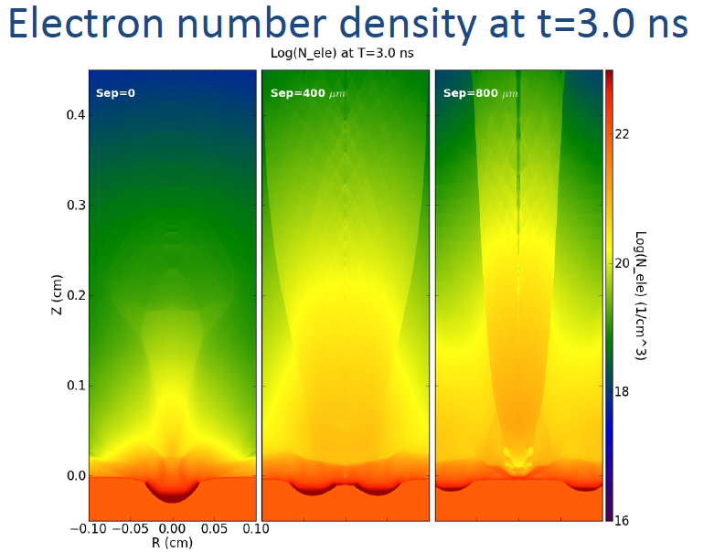
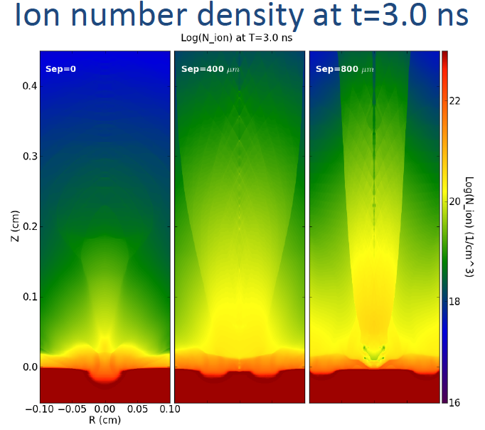
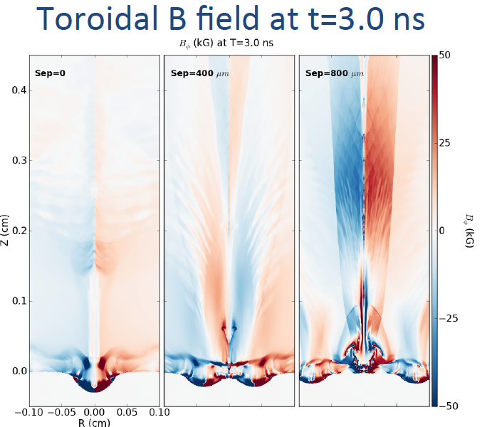
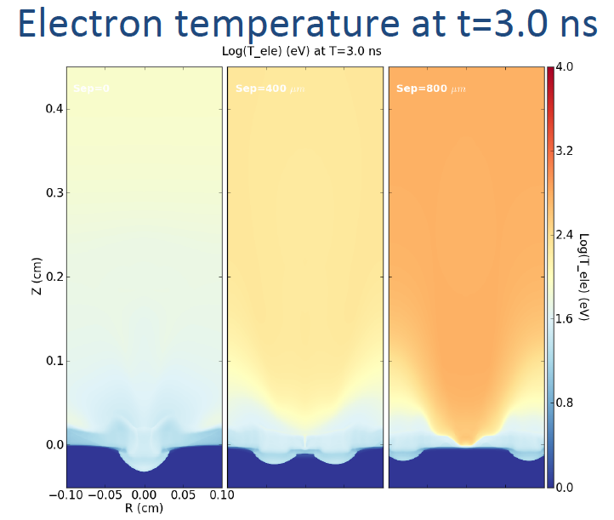
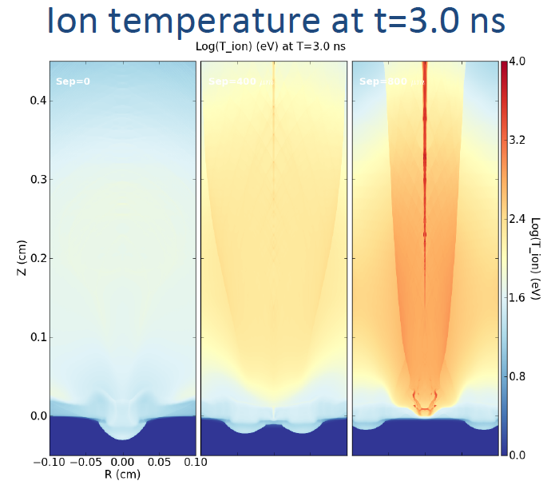
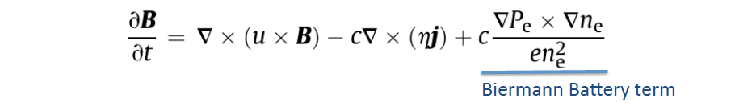
2D FLASH Predictions for d = 0, 400, 800 microns
However, 2D FLASH predicts only ~10⁴G toroidal magnetic fields created
by the Biermann battery.

Slide 9
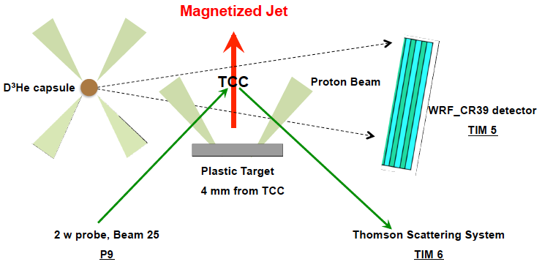
2015-16 Experiments used 20 OMEGA Laser Beams to form a Hollow Ring
Diagnostics Setup for the 20 OMEGA Beam Experiments
Side-on view
XRFC time-lapse X-ray Imager
or Ω-EP protons
17 cm from TCC
2.5
TS
3 primary diagnostics: Thomson Scattering (TS) at TCC, Proton-radiography (Prad), X-Ray Framing Camera (XRFC)

Slide 10
EPW
IAW
t(ns)
TS data at TCC
generally agree
with 3-D FLASH
predictions

Slide 11
P-rad images consistent with B_{z}-dominated laminar fields increasingly concentrated near axis
as d increases.
P-Rad Images at t ~ 3 – 4 ns
Max. B_{z} exceeds 1 MG
d = (a) 0, (b) 400, (c) 800, (d) 1200 μm

Slide 12
Colliding Jets Experiment Set-up & Diagnostics
on Oct 13, 2020 and August 11, 2021
Other Diagnostics
XRFC
D³He
TCC
TS
Beam 25
D=800μm, separation = 6.4 mm

Slide 13
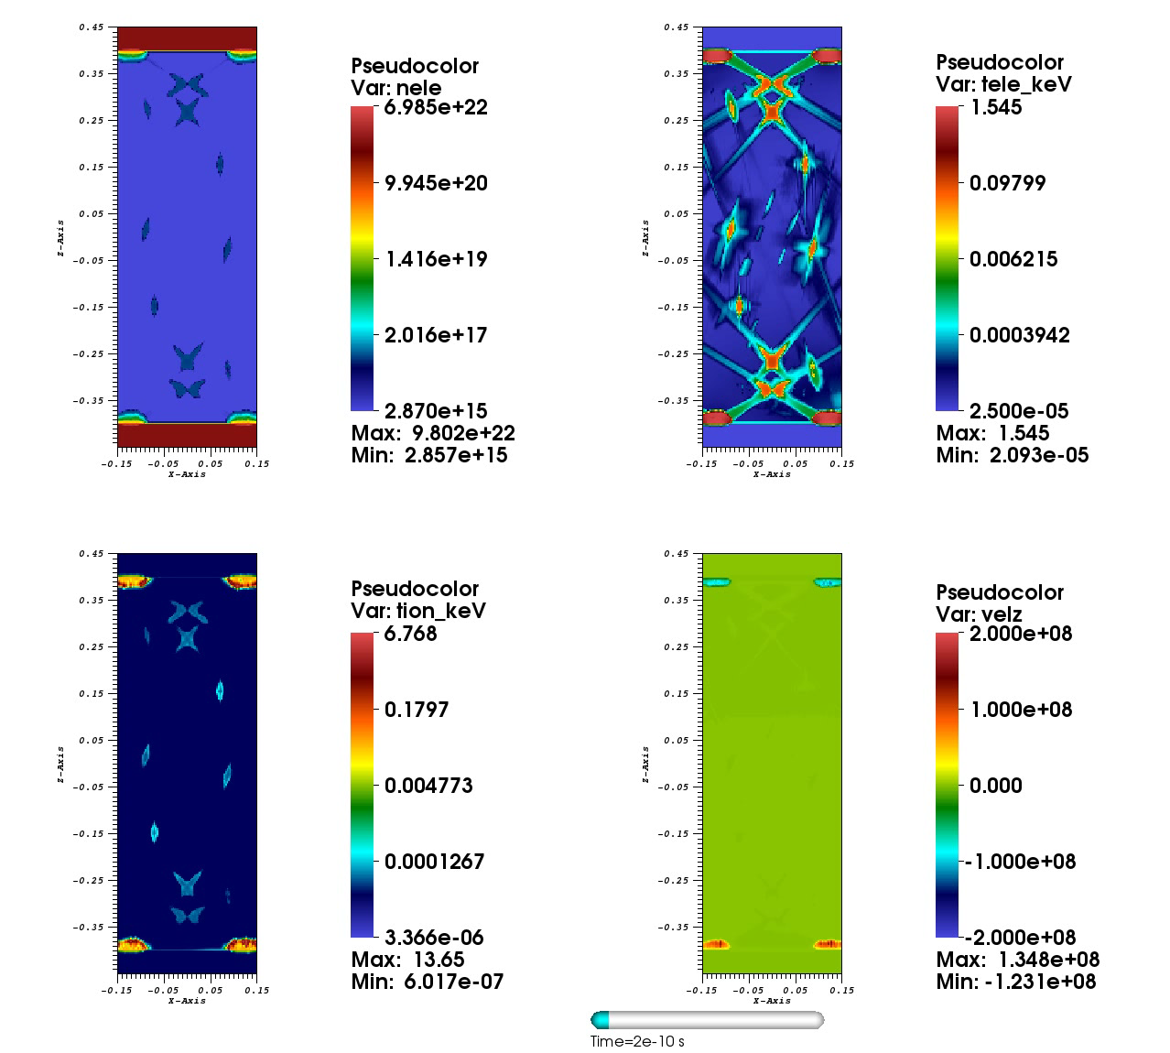
3D FLASH
Simulations
of d=800μm
colliding jets

Slide 14
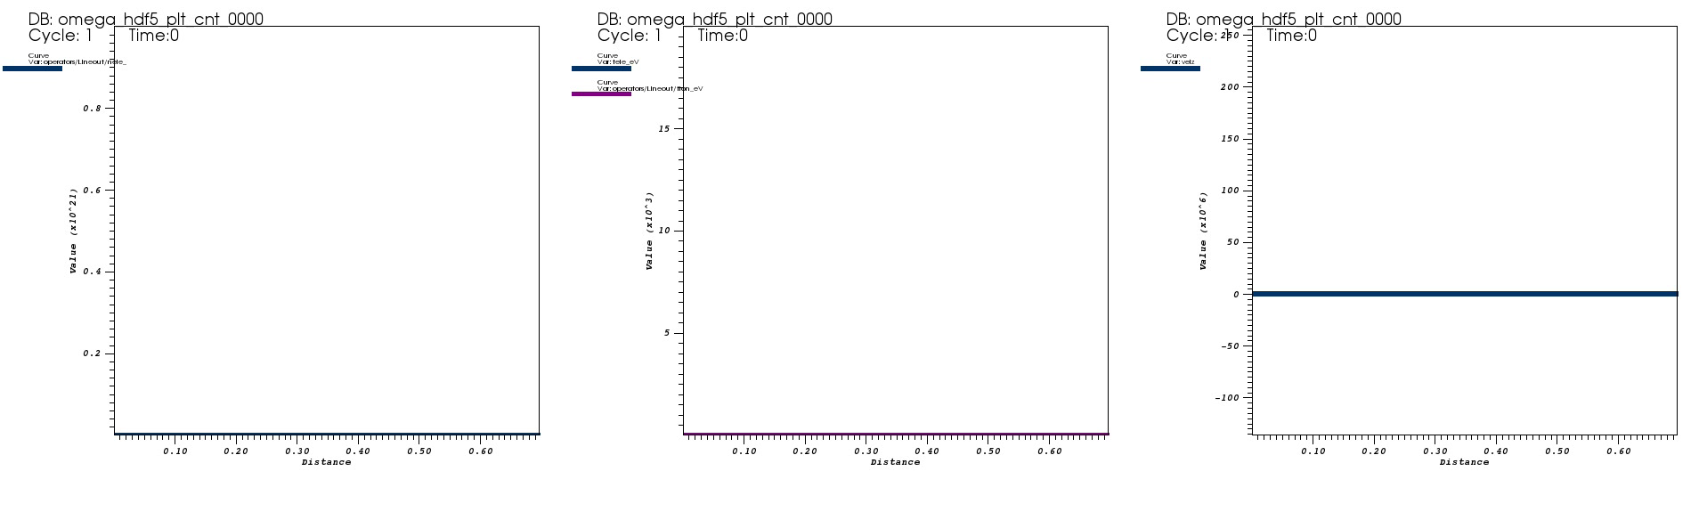
Time evolution of colliding jet parameters along jet axis
density
T_{e} , T_{i}
v_{z}

Slide 15
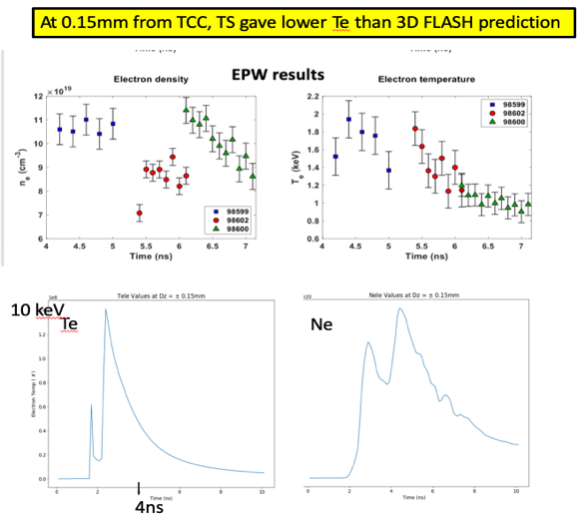

Slide 16
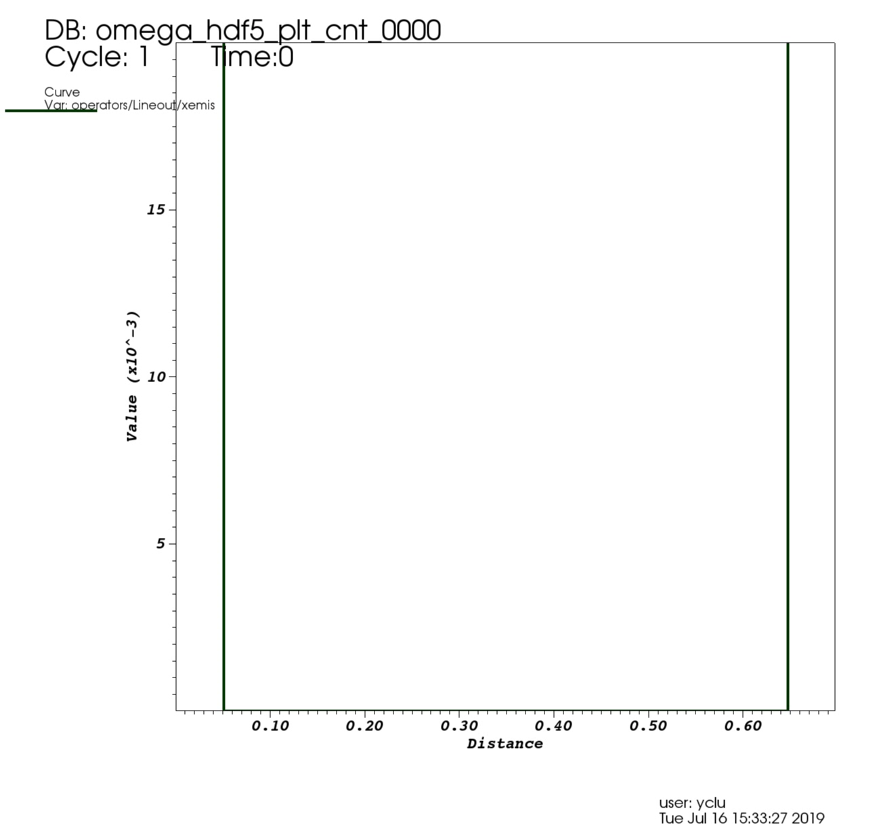
a
b
a
b
c
d
c
d

Slide 17
Colliding jets should create strongly magnetized shocks
with transverse B-fields near the contact surface
and parallel B-fields upstream
electron thermal
conduction should
be inhibited near
contact surface

Slide 18
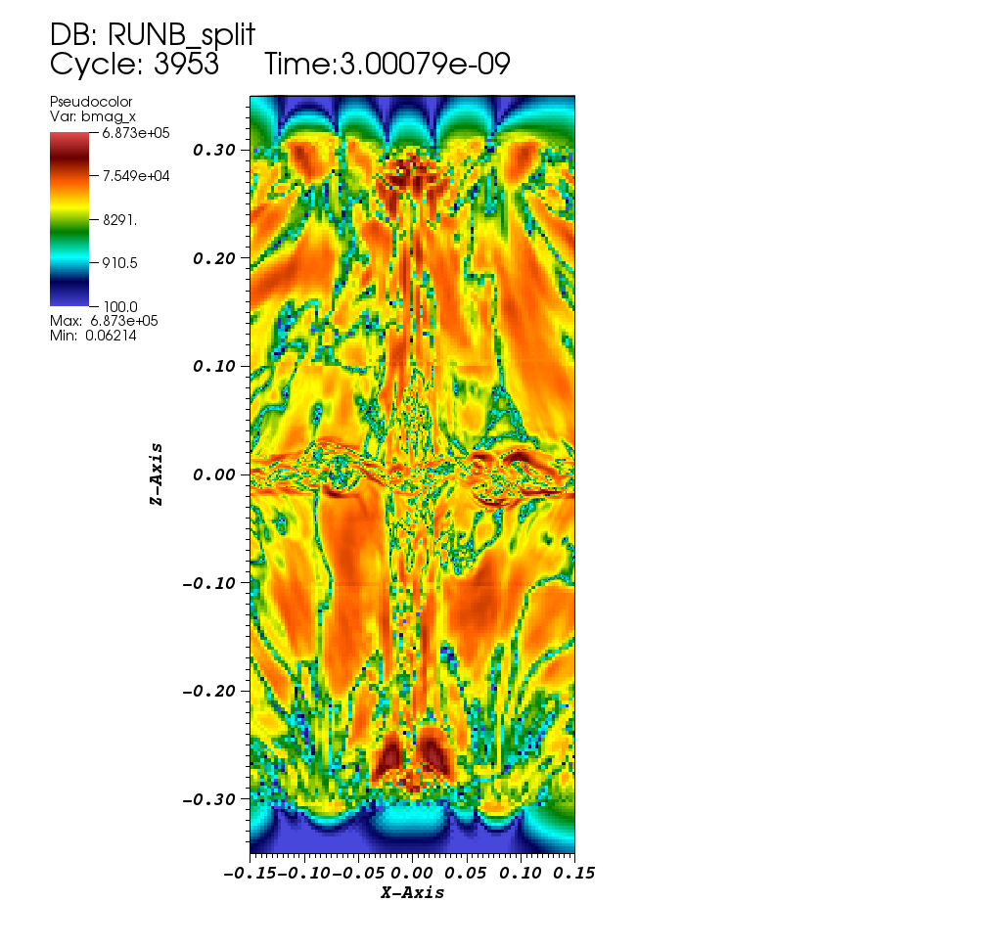
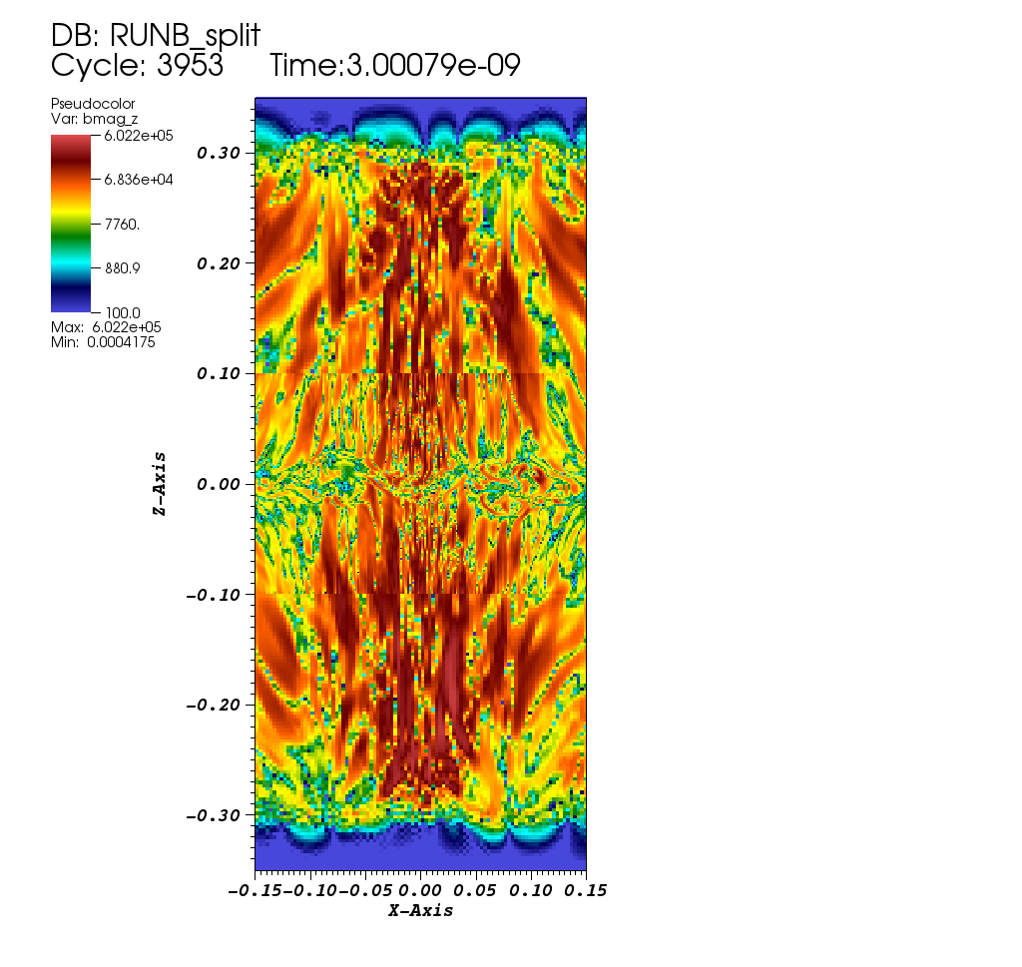
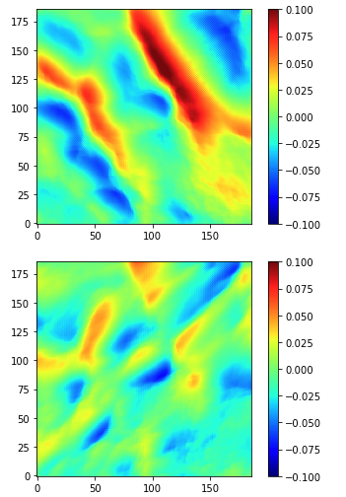
jet axis
Prad data
contact surface
B_|_
B||
B_|_
B||

Slide 19
Next experiments planned for Project A
  Add Fe & Sn dopants to CH targets to increase radiative cooling, to study radiative magnetized shocks.
  Study nonthermal particle acceleration by the magnetized shocks
  Study fusion reactions of D, T, Li in strong magnetic fields.
  Propose much larger scale experiments on NIF , using 64 NIF beams for each hollow
  ring.

Slide 20
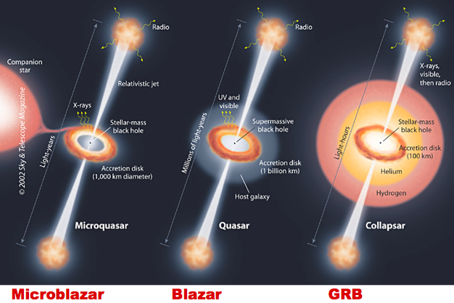
Project B uses the TPW laser in Austin, TX
Goals: create & study the physics of pair plasmas and GRBs
~ few 10’s 1000
GW 170817
n₊>10¹⁶/cc
n₊>10¹³⁻¹⁴/cc
ε_{γ} >10¹¹⁻¹² erg/cc
relativistic outflows in astrophysics emit intense gamma-rays
and are likely dominated by e+e- pairs

Slide 21
peak
osc.
our TPW expts.
30 MeV
Eddington Flux @ NS surface

Slide 22
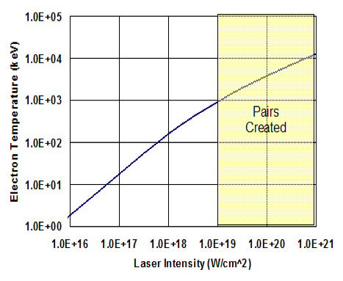
Ultra-intense laser irradiating thick high-Z solid targets is
the most efficient tool to create dense gamma-rays & pairs
(Cowen 1999, Chen 2009, 2010, Gahn 2000, Sarri 2015)
TPW
BH favors
thick target
Bethe
Heitler
e+e-
γ
LASER
MeV e-
MeV e-
e+e-
Trident
high-Z solid target
higher laser intensity => hotter electrons => more &
higher energy gammas => more pairs + easier escape

Slide 23
goal is to achieve highest gamma-ray & pair density and highest e+/e- ratio

Slide 24
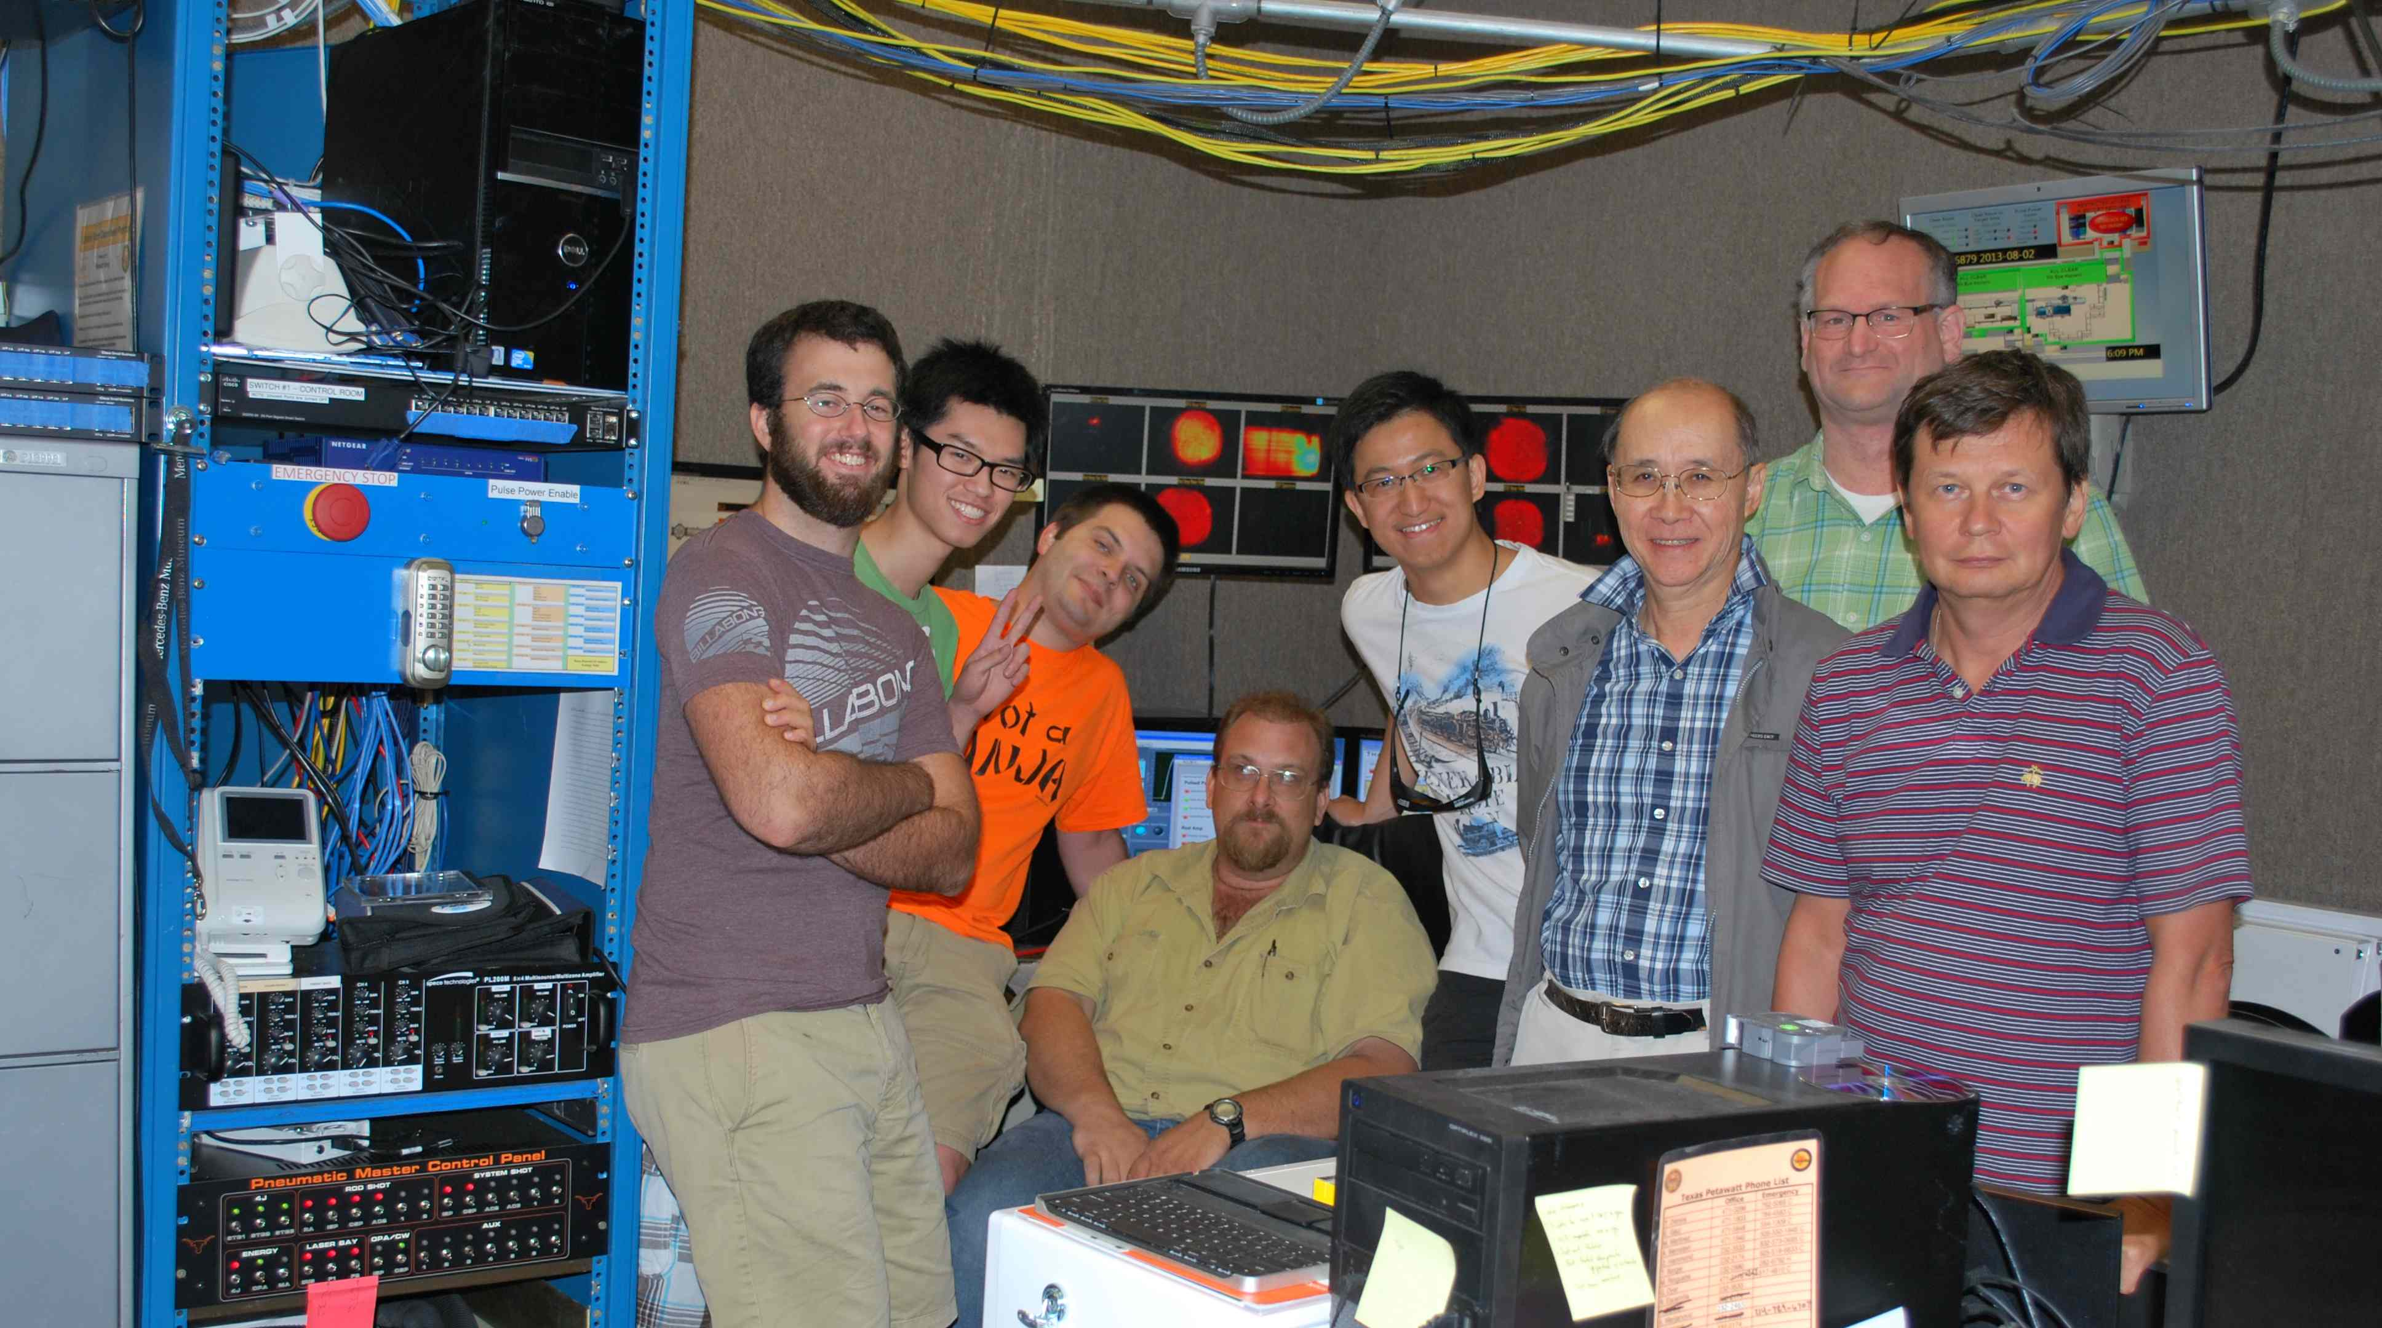
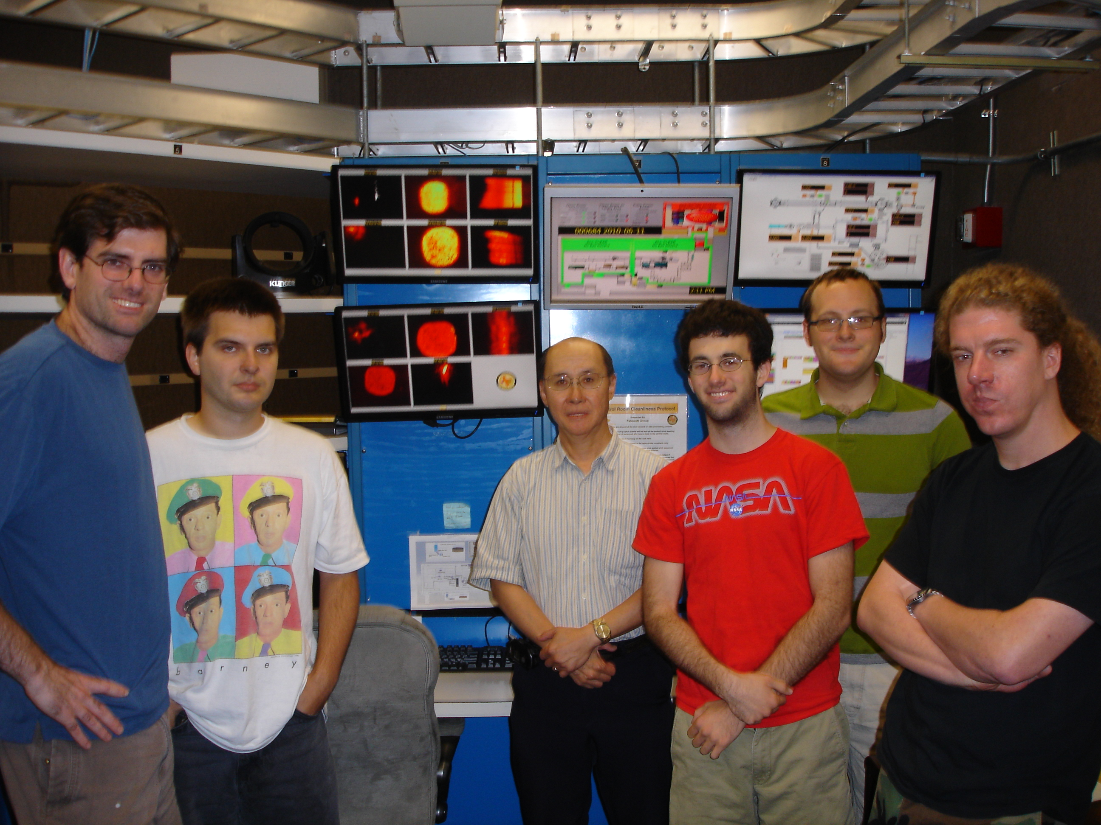
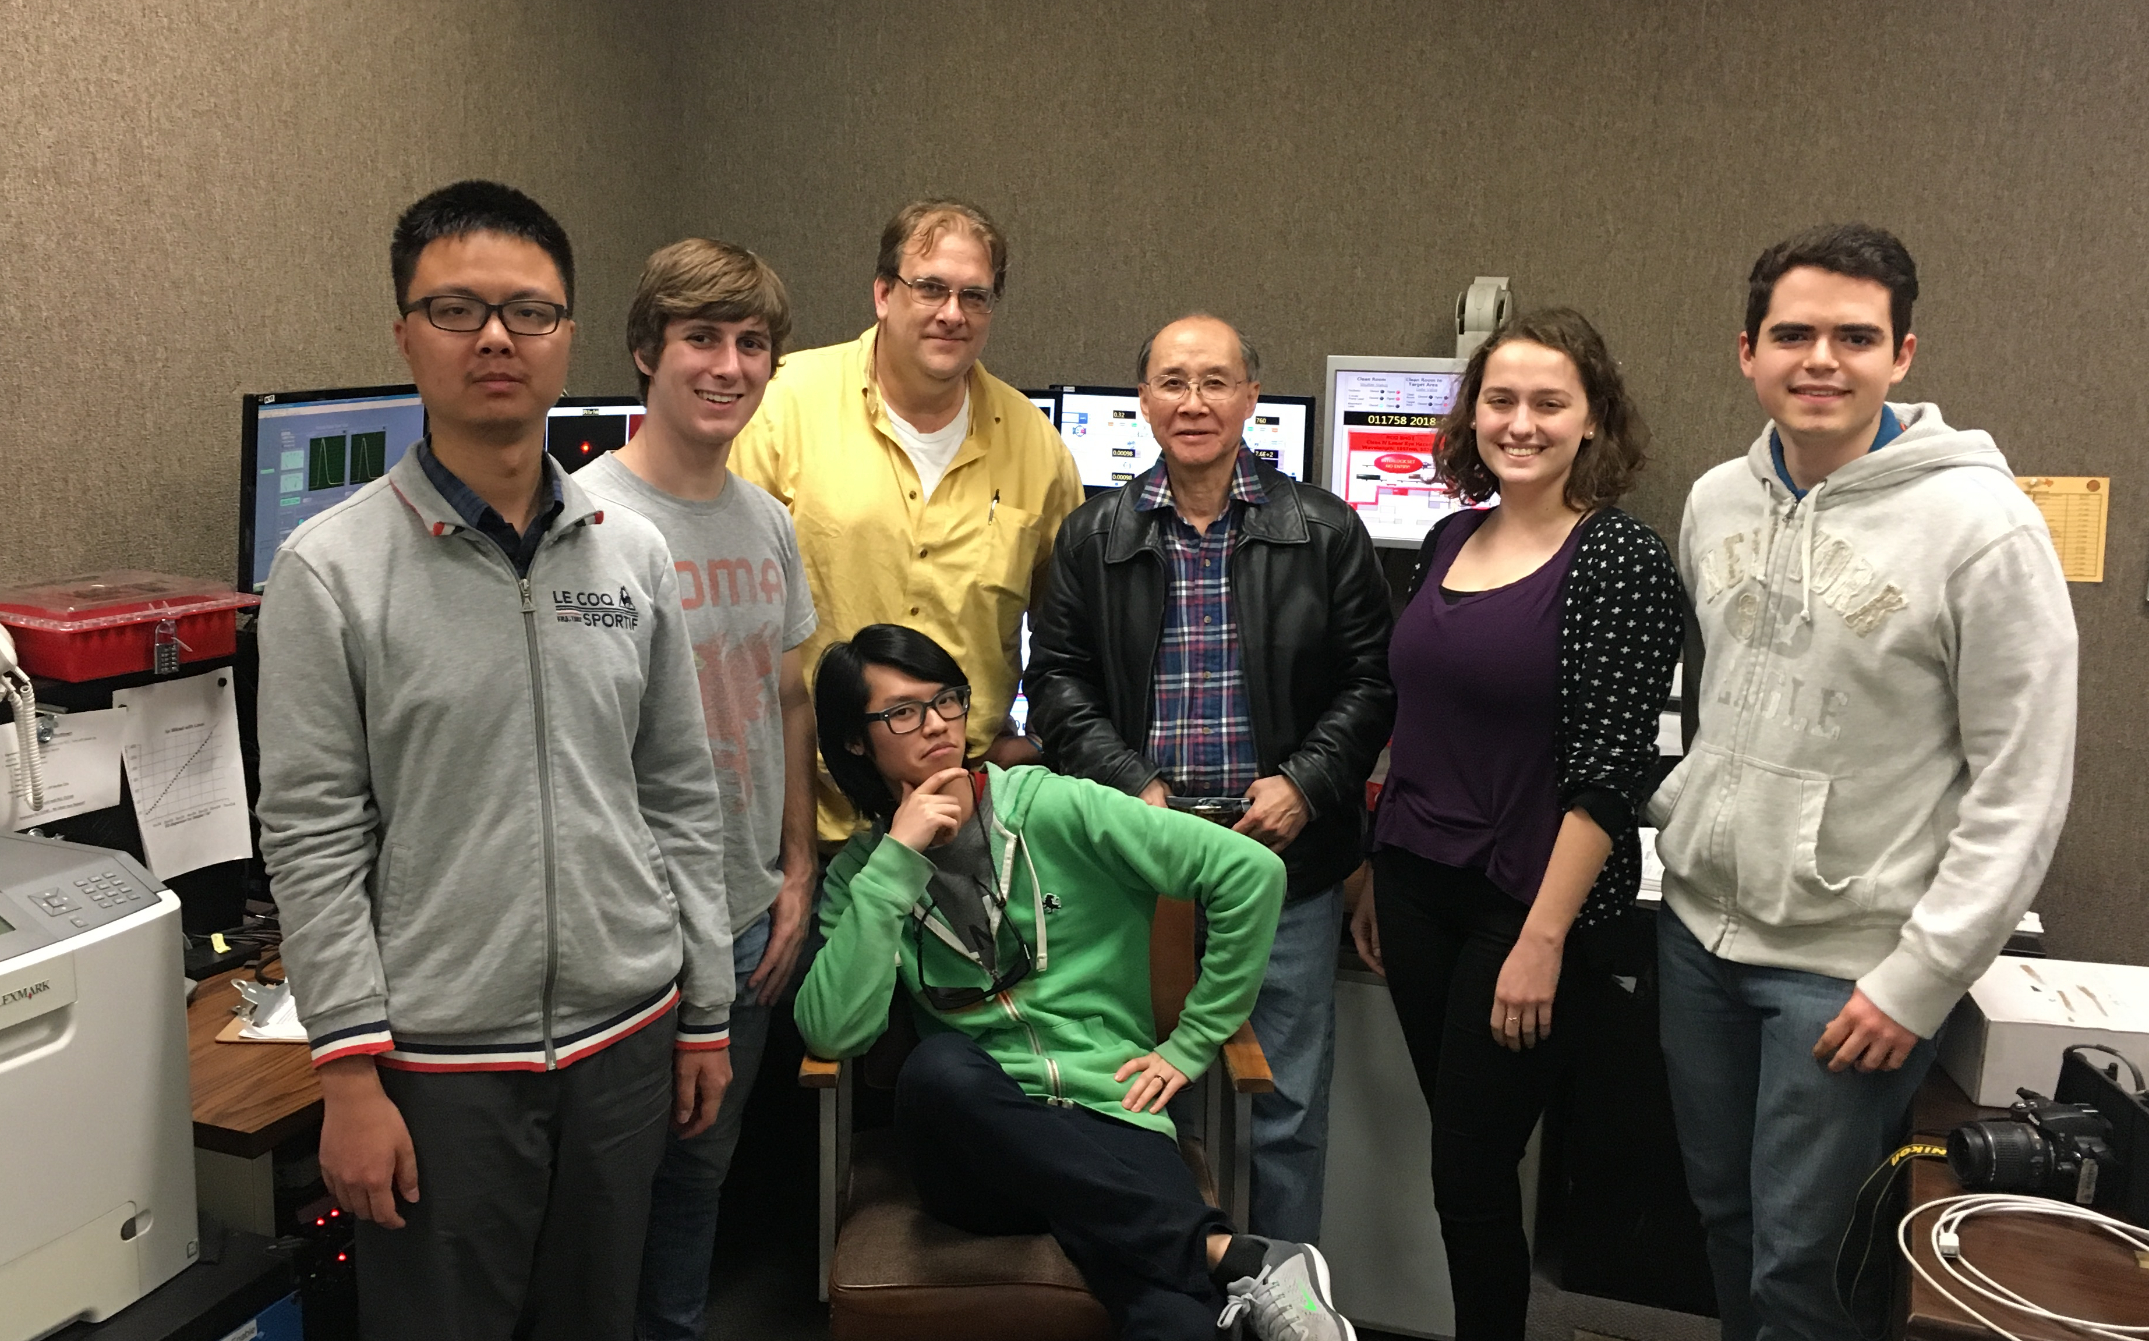
Collaborators
Rice: Zheng, Burns, Lo, Henderson, Chaguine, Taylor, Clarke, Cen, Zhou, Hua, Yao, Lu, Marchenka, Fasanelli, Zhang, Wang, Fu; UT : Dyer, Hasson, Dashko, Glen, Riley, Serratto, Tiwari, Quevedo, Donovan, Ditmire; MD Anderson : Wong, Zhang
(see www.nature.com/articles/
srep13968 for earlier results)
(see https://youtube/
oB2WtiEfyBQ for APS TPW movie)

Slide 25
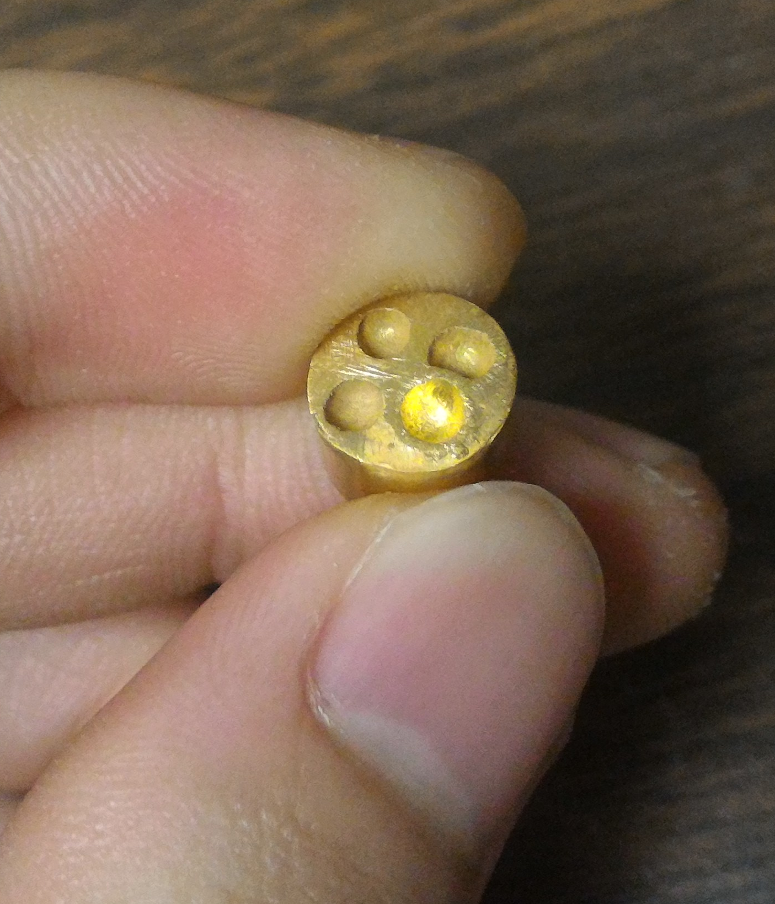
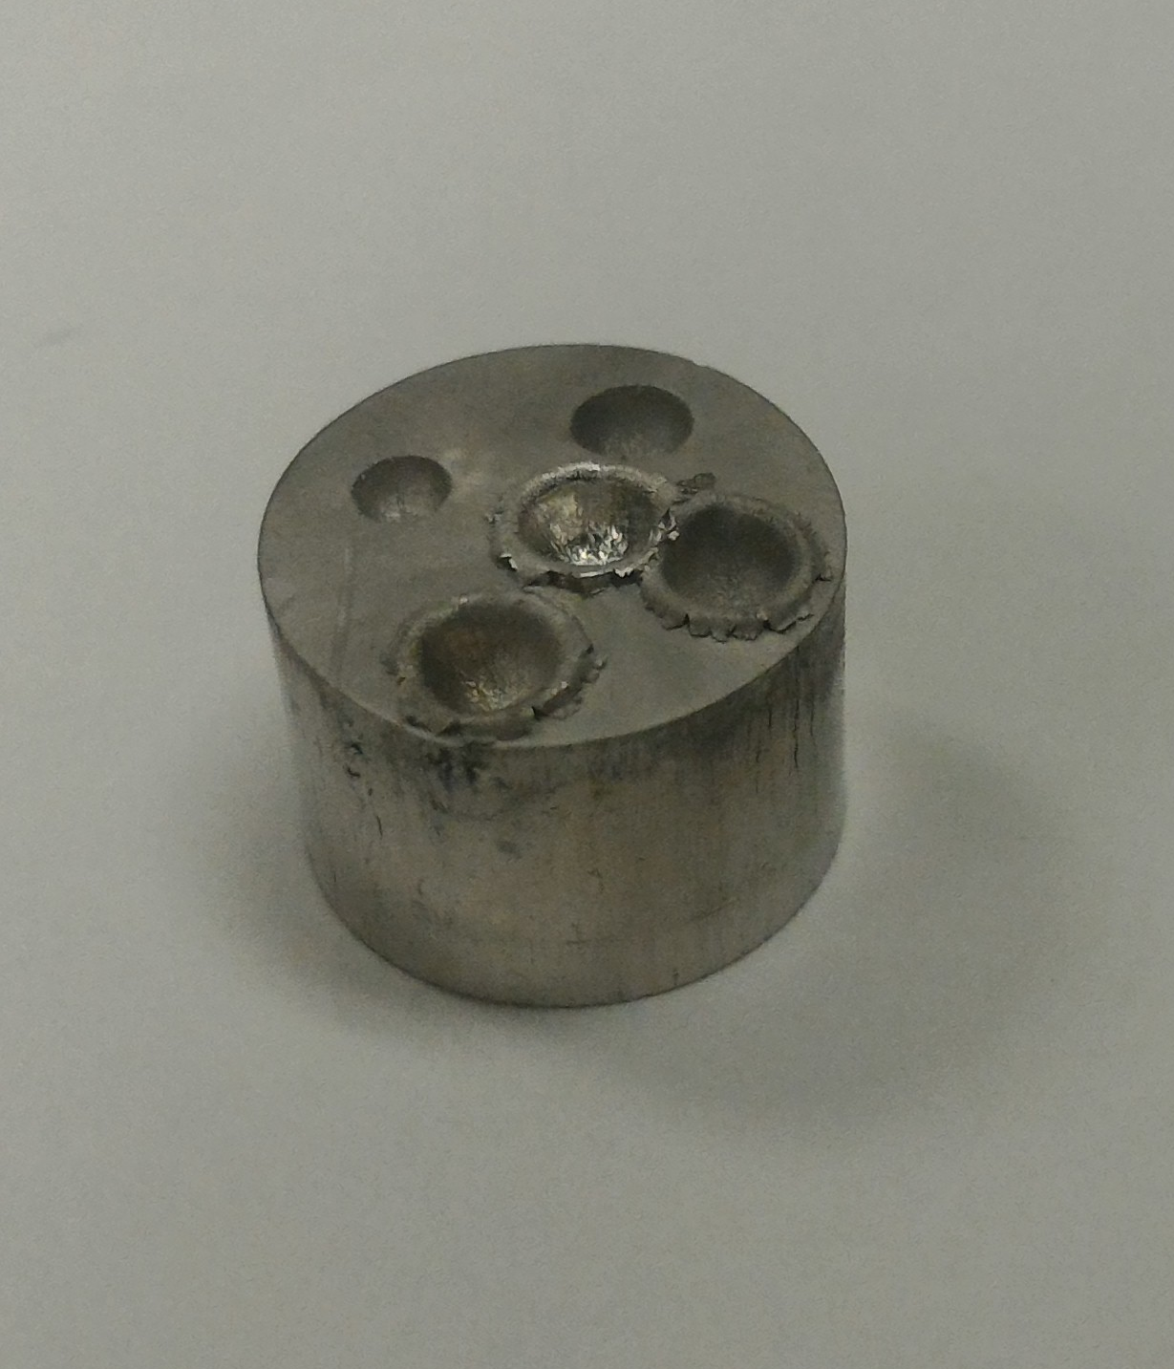
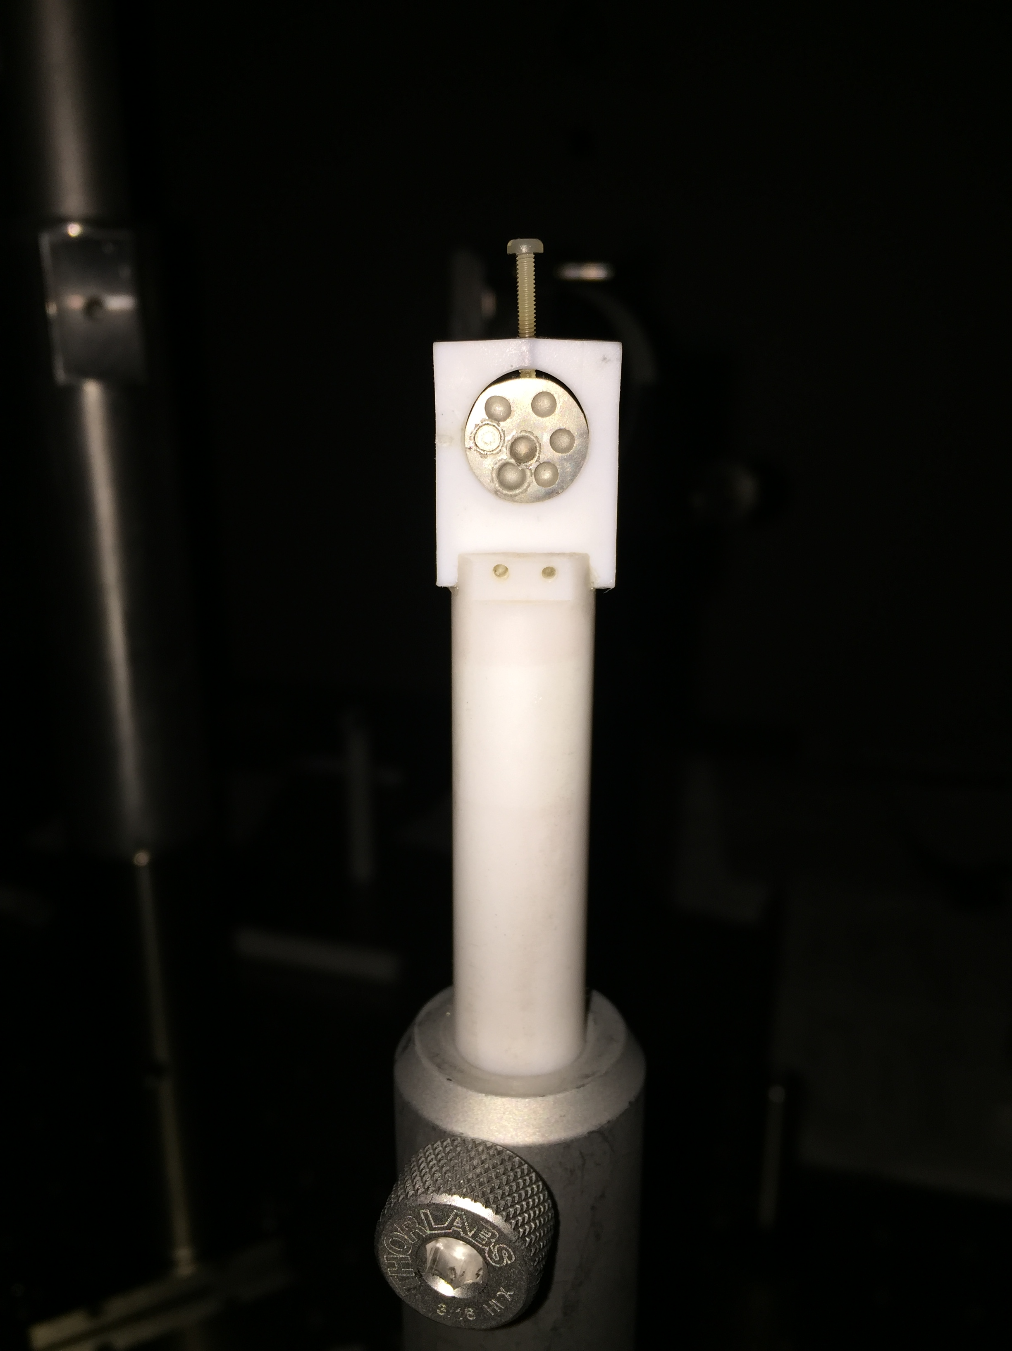
Sample Slugs with
Multiple Craters
Au craters are larger
than Pt craters

Slide 26
Major milestones achieved in recent TPW experiments
Maximum gamma-ray yield ~ 5% of laser energy
2. Emergent γ-ray density from target is similar to
γ-ray density observed in cosmic GRBs (~10¹¹erg/cc).
Emergent pair density reaches ~ 10¹⁵/cm³, exceeding
the pair densities postulated in GRBs. Also R ~ 5c/ω₊,
marginally qualifying the pairs as a “plasma”
4. For cm-size large targets, we discovered e+/e- >>1 within a
cone centered between Laser Forward and Target Normal
directions.

Slide 27
Comparison of TPW e+ yield
with previous laser experiments
and theoretical models
2016-18
+TPW
Chen et al 2015
2012-13
~(Iλ)^{1/2}
|10 ²¹

Slide 28
We are at the threshold of achieving a true“pair plasma”
to characterize and study a “pair plasma”, we need
pair jet transverse size R >> “pair skin depth”
Rω₊/c ~ (N₊/Δt)^{1/2}
Rω₊/cγ^{1/2} ~ (N₊/γΔt)^{1/2}
Our Max (Rω₊/c) ~ 5
Our Max (Rω₊/cγ^{1/2} ) ~ 2

Slide 29
We found e+/e- ratio > 1 within a cone between
LF and TN for target thickness ≥0.6 mm
LF
TN

Slide 30
Pt produces higher e+/e- than Au
Thickness Pt Au
1 cm
9.1 mm
8.2 mm
7.5 mm
7.1 mm
Cone lies between Laser Forward and Target Normal.
Red arrows denote e+/e- > 5. Purple denotes e+/e- >1.
TN-17
TN-6
TN-9
TN
TN-17
TN-3
TN-17
TN-9
TN-6
TN
TN-9
TN-9
TN
TN-12
TN-9
electrical conductivity likely played a role in the suppression of e- emission

Slide 31
positron results summary
We have experimentally demonstrated a new
way to create a dense (≥10¹⁵/cm³), short-pulse
(<100fs), multi-MeV “pure” positron jet.
If such positrons can be trapped magnetically, we
can create a long-living dense pure positron plasma.

Slide 32
Gamma-Ray Data
1. total gamma yield ~ 5%
of laser energy
2. dosimeter data show 15º
gamma-ray beam centered
@ ~10º from Laser Forward
3. Broad Band spectra were
consistent with ~few MeV
bremsstrahlung.
Biggest challenge:
how to measure
short-pulse ultra-intense
γ-ray spectrum since
single-photon counting
does not work?

Slide 33
Current Spectrometers for Short-Pulse Intense Gamma-Rays
Filter Stack or Wedge Attenuation: limited to a few energy channels <~ 6 MeV
Forward Compton Scattering: low S/N, limited to high flux, low background
Nuclear activation Threshold: limited to high flux, very few energy channels

Slide 34
New Approach:
Use high-resolution 2D imaging of light pattern
emitted by finely pixelated scintillator matrix
had been used in High Energy Physics, also recently in LWFA accelerator experiments, for gamma-rays ≥ 100 MeV, with limited success. So far only crude model input spectrum with few parameters has been obtained using iterative Monte Carlo simulations
……….…..
Team members: Kevin Qinyuan Zheng, Kelly Yao, Willie Lo, Aileen Zhang, Rice University; Gary Wong, Yuxuan Zhang, MD Anderson Cancer Center; Andriy Dashko, Hannah Hasson, Hernan Quevedo, Todd Ditmire, UT Austin

Slide 35
SAS (Scintillator Attenuation Spectrometer) adopts new advances in medical imaging technology
Large 2D matrix (e.g. 36x60) of mm-sized pixels provides high resolution images with hundreds of bright pixels.
LYSO.Ce scintillator has highest light output (50000 blue photons per MeV energy absorbed). High-Z and high density (7.8gm/cc) can attenuate 50 MeV gamma-rays in a few cm.
100% reflective coating for each pixel traps all light emitted in each pixel. Emergent light from each pixel faithfully represents energy deposited in each pixel with no light contamination between pixels.
Sensitive high-speed high-contrast non-cryogenic CCD camera capable of high rep-rate imaging of LYSO light pattern even from faint gamma-ray sources
Insensitive to EMP and high neutron flux

Slide 36
Design and Layout of SAS
LYSO matrix block, crystal holder and CCD camera are housed
in a black light-tight box the size of a shoe box
collimated
gamma-rays
36 x 48 matrix measures 6 cm H x 8 cm W x 1 cm D
3mm – 6mm pinhole collimates gamma-rays along central axis

Slide 37
Sample SAS image of LYSO scintillation light pattern of Shot
10026 from a 2016 TPW experiment. This image contains
over 400 bright pixels.

Slide 38
Use GEANT4 to accurately simulate
light patterns from LYSO matrix
0
We create 200 light patterns from 200 GEANT4 simulations of
monoenergetic gamma-ray energies from 0 – 50 MeV
with 0.25 MeV intervals

Slide 39
200 x 200 Detector Response Matrix shows importance of 2D imaging
5 columns of
48 pixels
combined into 200 “effective pixels”

Slide 40
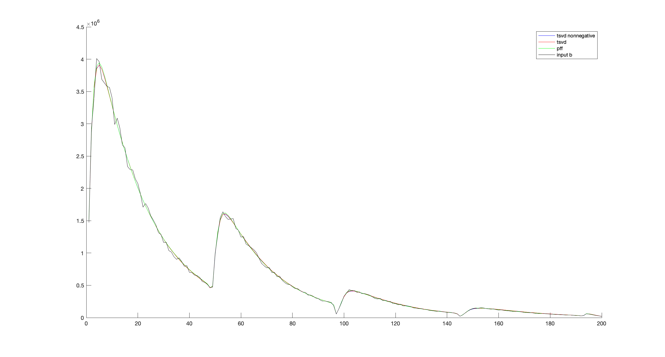

Test with 3-component incident model spectrum

Slide 41
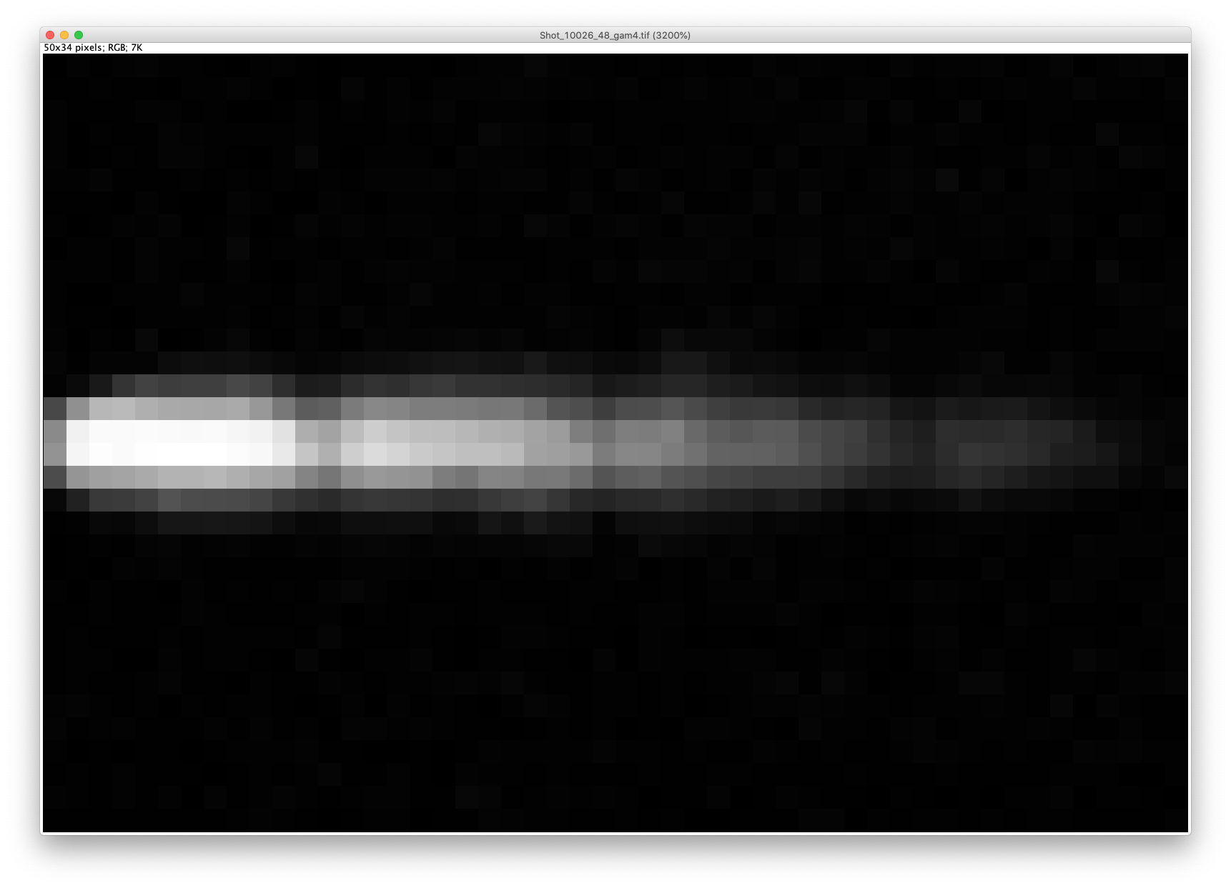
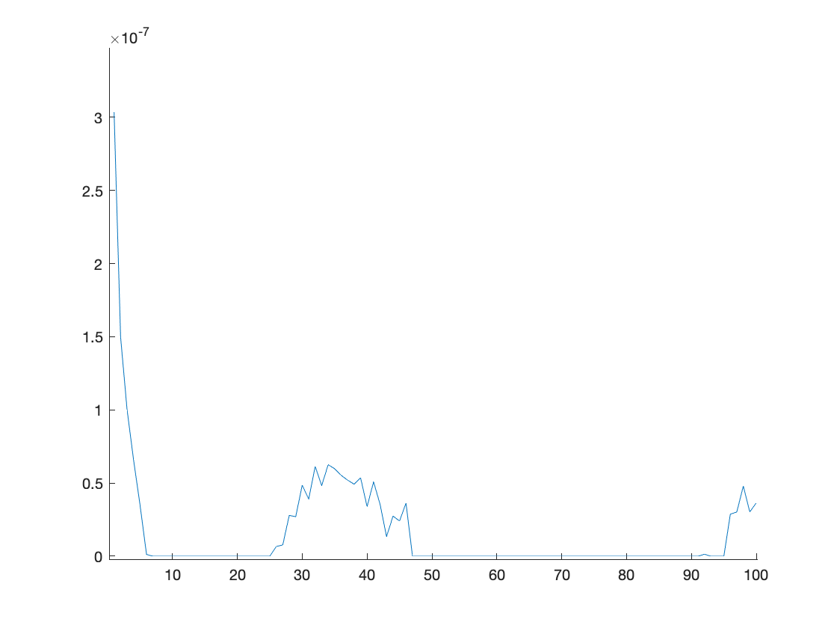
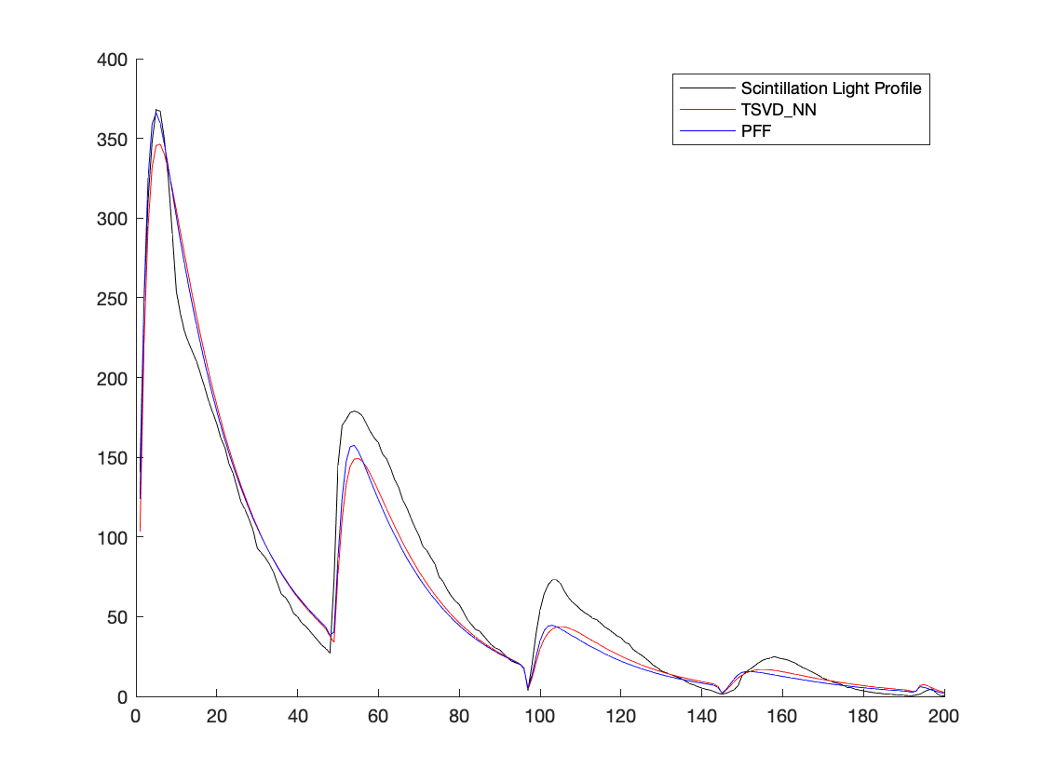
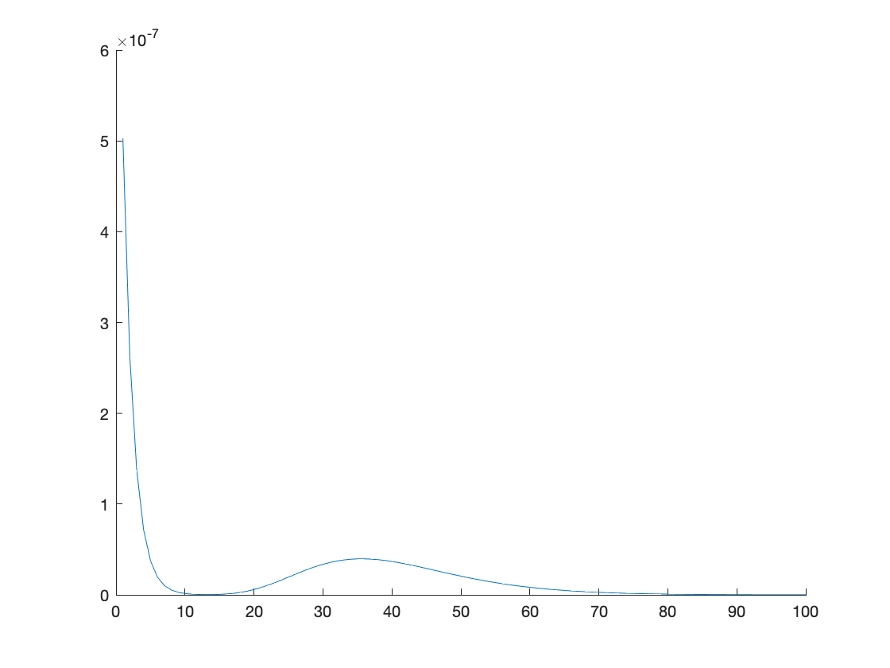
Gamma-ray Spectrum Inverted from Shot 10026 SAS Image
TSVDNN
x 0.5MeV
PFF
x 0.5MeV
~ MeV exponential + 17-18 MeV bump

Slide 42
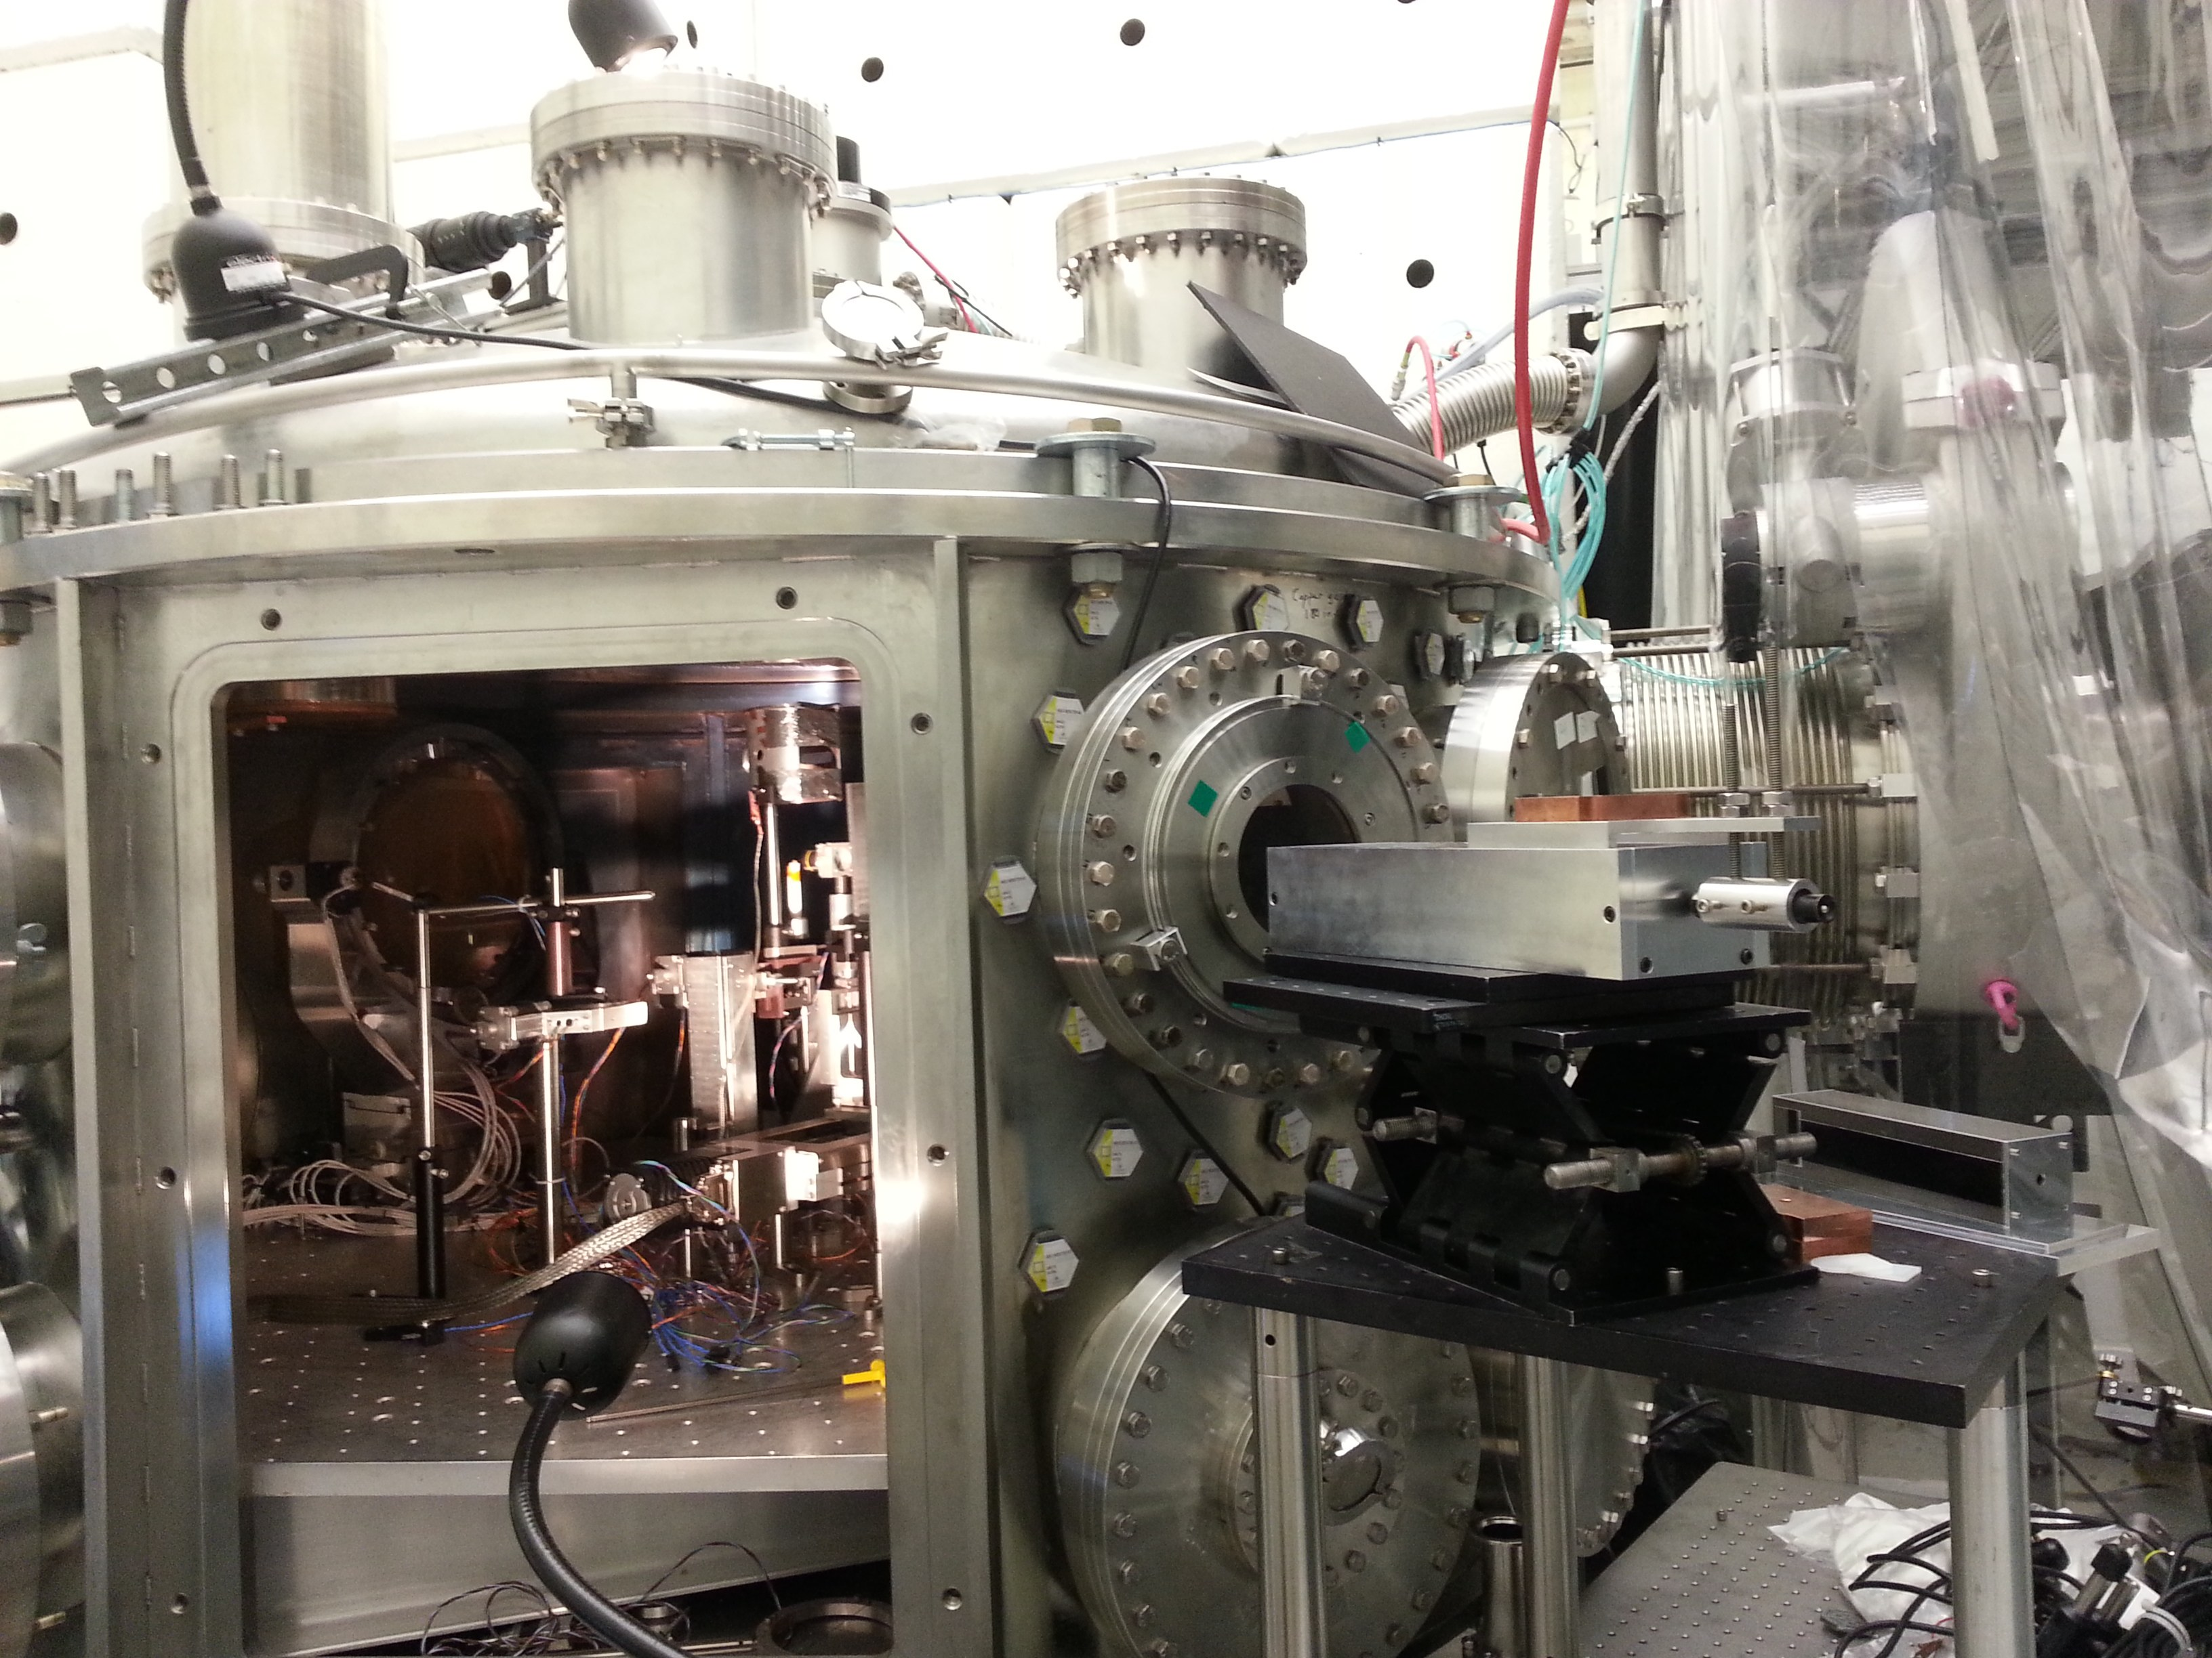
Sample 2018 TPW SAS Data
TN + 90º
TN

Slide 43
Next TPW experiments in 2022
New application: exploit the 15-20 MeV gamma- ray excess to study photo-nuclear physics

Slide 44
Summary of Project B
SAS is a new type of gamma-ray spectrometer designed for high resolution, high S/N, high rep-rate applications in short-pulse laser experiments
Can measure gamma-rays up to 100 MeV with 0.5 MeV spectral resolution
We have developed a robust, stable inversion algorithm to extract reliable spectrum
SAS led to discovery of 17-18 MeV gamma-ray “bump” in TPW experiments

Slide 45
Table 1. Sample parameters of the d=800 mm jet
at 3.5 ns and 2.5 mm from laser target
compared to those of YSO jets.
d=800 mm OMEGA jet YSO jet
Electron density n_{e} ~ 1.5 x 10²⁰ cm⁻³ ~ 10² – 10⁵ cm ⁻³
Electron temperature T_{e} ~ 1 keV ~ 10⁴ K – few x 10⁶ K
Ion temperature T_{i} ~ 2.5 keV ~ T_{e}
Ionization <Z> ~ 3.5 low – 100%
Flow velocity v ~ 1.2x10⁸ cm/s ~ few x 10⁷ cm/s
Magnetic field B ~ 10⁶ Gauss ~ 20 – 500 mG
Plasma Beta β = 8πP_{g}/B² ~ 10 ~ 10 - 10³
Mach number M=v/c_{s} ~ 3 ~few - 10
Alfven Mach number M_{A} = v/v_{A} ~ 8 ~ 10²
Reynolds number R_{e} ~ 10⁴ ~ 10 - 10³
Magnetic Reynolds number R_{eM} ~ 10⁴ ~ few x 10²
Peclet number P_{e||} = 1.5kn_{e}vR/k_{T||B} ~ 0.3 unknown
P_{e orth} = 1.5kn_{e}vR/k_{T orth B} ~ 30 unknown
Hydro time/Rad. cooling time (CH) ~ 0.01 various
Hydro time/Rad. cooling time (2%Fe) ~ 1
Electron skin depth c/ω_{e} ~ 0.4 μm
Ion skin depth c/ω_{I} ~ 24 μm
Debye length v_{e}/ω_{e} ~ 0.01 μm
Electron gyroradius v_{e}/ω_{Be} ~ 0.6 μm
Ion gyroradius v_{i}/ω_{Bi} ~ 20 μm
Coulomb scattering mean free path l_{ei} ~ 20 μm

