Slide 1
Relativistic Shear Flows:
Field Generation, Particle
Energization and Radiation
Edison Liang, Rice University
Collaborators: Wen Fu, Jake Spisak, Markus Boettcher
Work supported by NASA & NSF
DPP Mini-Conference Nov. 2015

Slide 2
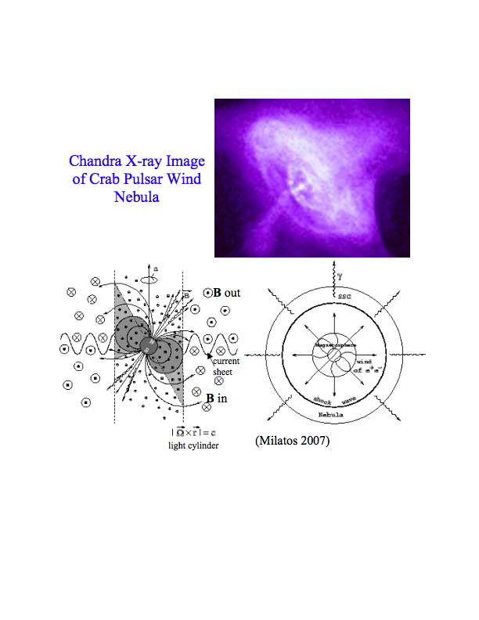
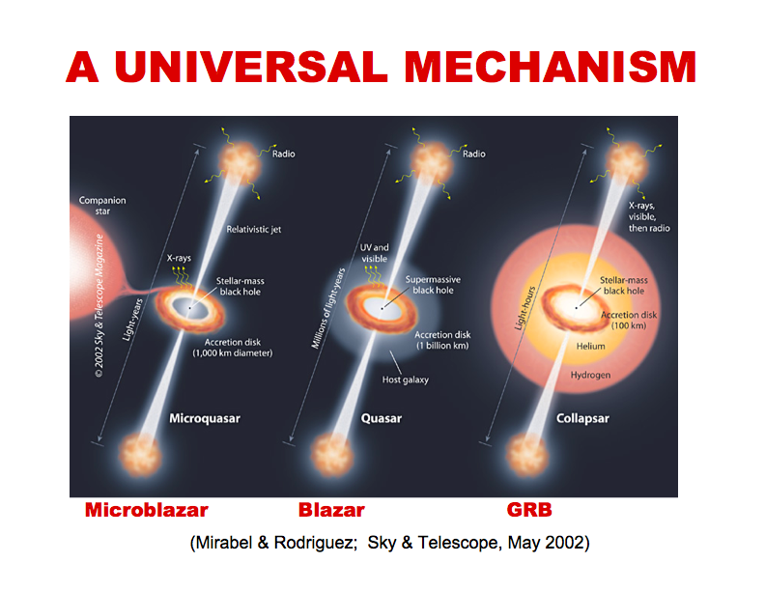
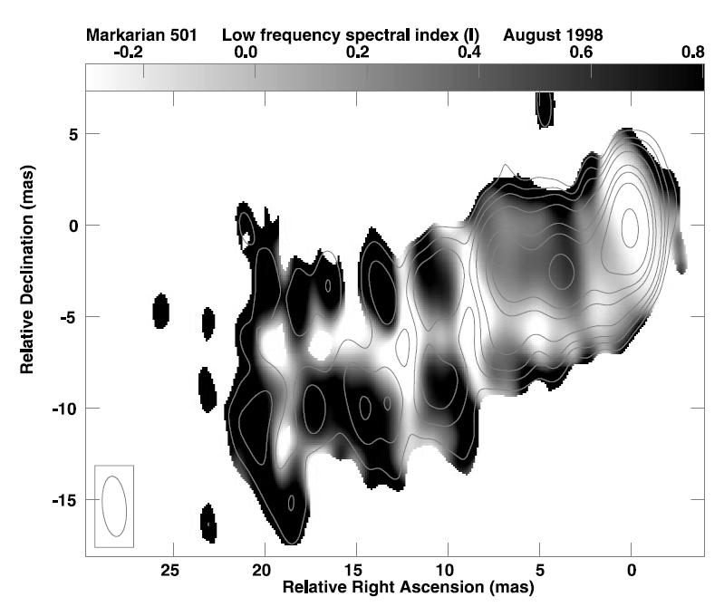
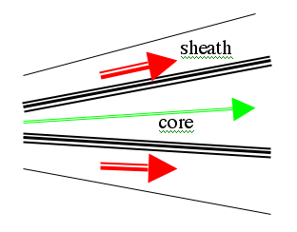
Relativistic shear boundary layer (SBL) likely
ubiquitous in many astrophysical outflows
Pulsar wind
Limb-brightening of radio galaxies in VLBI observations consistent with boundary layer emission of core-sheath jets
(from Giroletti et al. 2004).
Low-Γ
High-Γ
enhanced synchrotron emission
requires strong B-field and
particle acceleration
Low-Γ

Slide 3
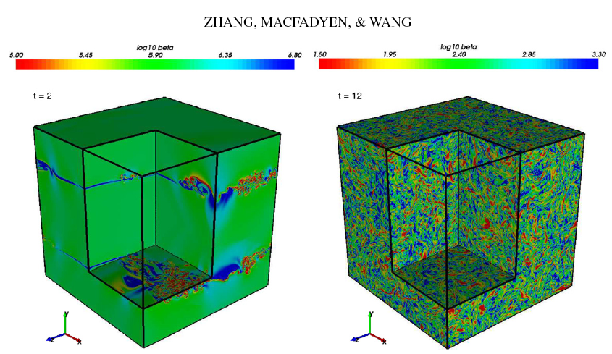
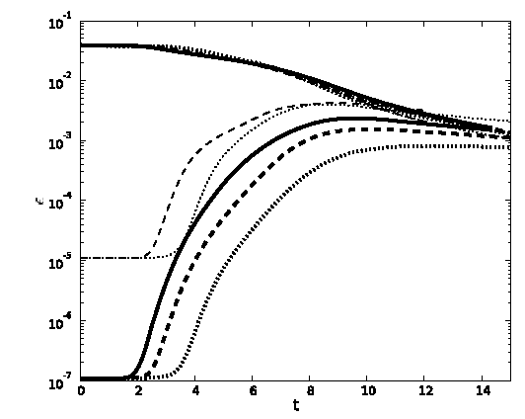
Previous RMHD simulations
show B field amplification
from seed fields via KHI
turbulence only up to e_{B}~5x10⁻³,
but no long-living
Macroscopic ordered fields.
Shear Flow Free Energy is
dissipated by turbulence
& thermalization
Em
5x10⁻³

Slide 4
PIC simulations of relativistic shear flows are performed in
the Center of Momentum (CM) frame so that Γ = 2p_{o}²
.
B_{o}=0 kT=2.5 keV n=1
m_{i}/m_{e}=1, 1836, p_{o}=15
20-40 particles/cell
yω_{e}/c
2048-
12288
p_{x}=-p_{o}
X
1536
0
p_{x}=+p_{o}
512
Transverse
plane (T)
p_{x}= -p_{o}
xω_{e}/c
1024
zω_{e}/c
Momentum-plane (P)
1024

Slide 5
We studied 4 Types of Relativistic Shear Flows:
100 % e+ e- m_{i}=m_{e}
100% e-ion m_{i}=1836m_{e}
Hybrid: 90% e-ion, 10% e+e-
4. e+e- sandwiched be e-ion
Codes used: 2D ZOHAR & 3D EPOCH

Slide 6
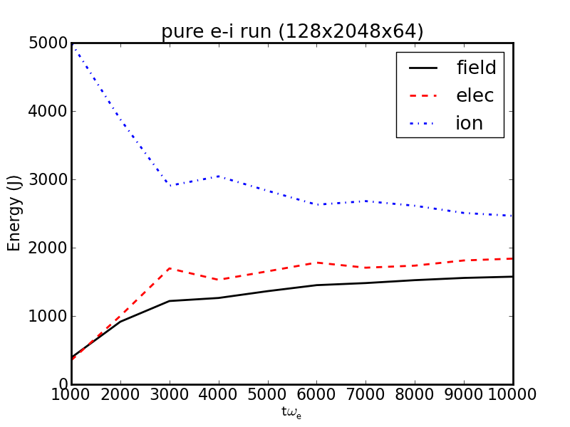
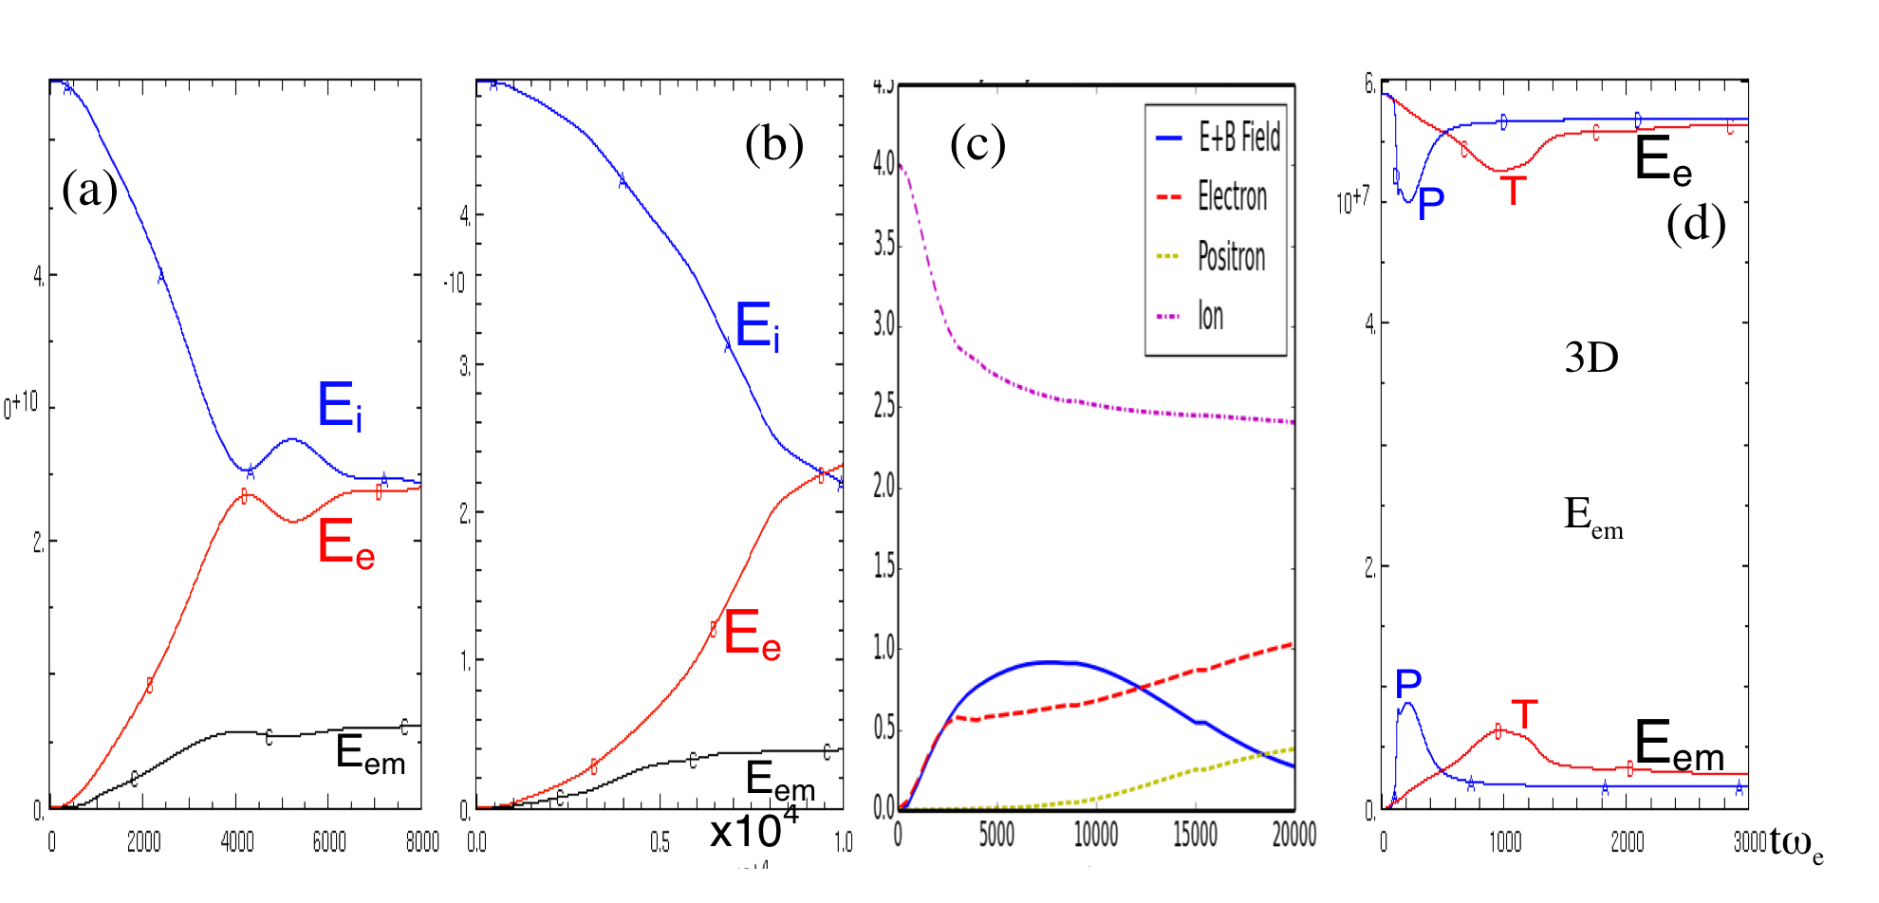
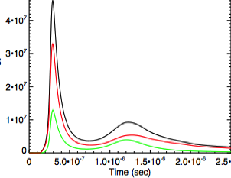
electron/leptons reach energy equipartition with ions
on time scale proportional to size of y
100%e-ion 90%e-ion10%e+e- e+e-/e-ion sandwich 100%e+e-
3D
E_{em}
3D
E_{em}
E_{em} saturates at ~ 8-12% of total energy

Slide 7
In ion-dominated shear boundary, fields are generated
by electron counter-current (ECC) instability
p_{ion}
p_{e}
J_{net}
B_{in}
Large scale monopolar d.c. slab field is generated

Slide 8
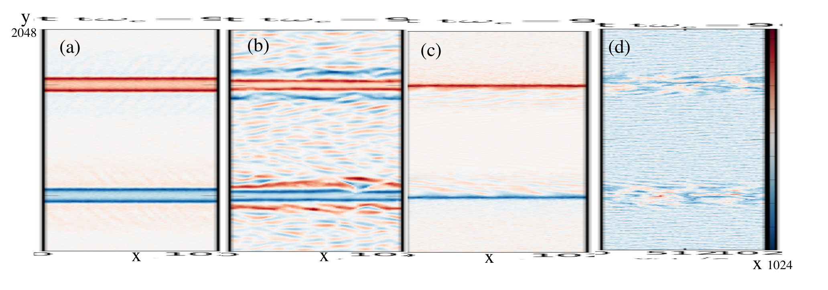
Field Generation by Relativistic Shear Flows
e-ion
90%e-ion
10%e+e-
mixture
e-ion
e+e-
e+e-
e-ion
B_{z} contour plots for p_{o}=15
p_{o}=bulk Lorentz factor in Center of Momentum Frame

Slide 9
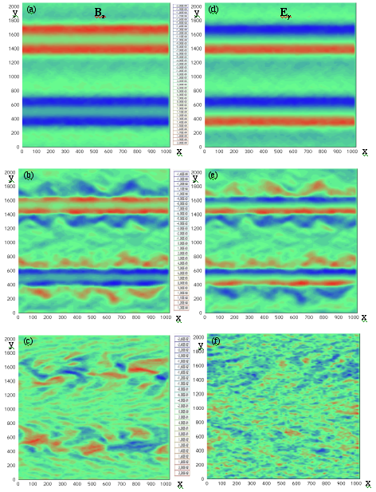
p_{o}=15
P-mode
dominates in
all Ion runs
Pure e-ion
In 3D runs,
oblique modes
generate
additional (B_{y},E_{z})
but they saturate
at amplitudes
<< (B_{z}, E_{y})
tω_{e}=3000
90% e-ion 10%e+e-
Pure e+e-

Slide 10
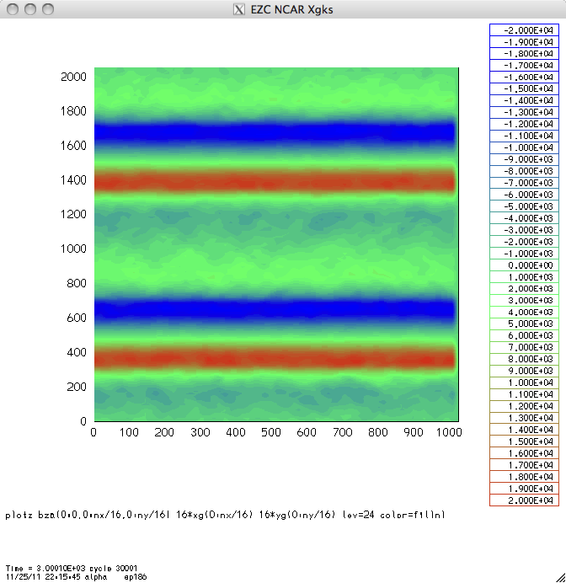
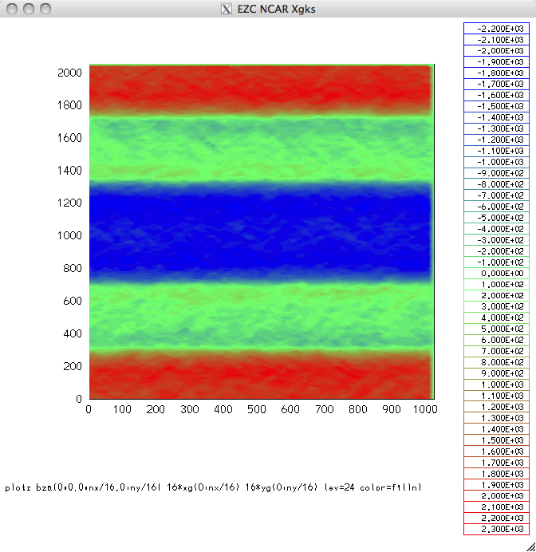
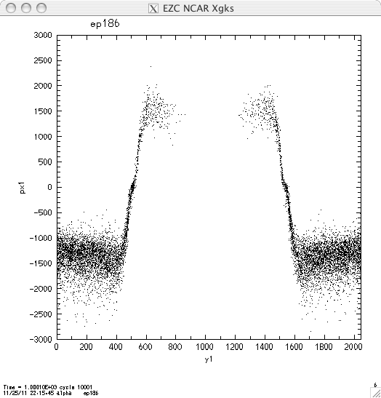
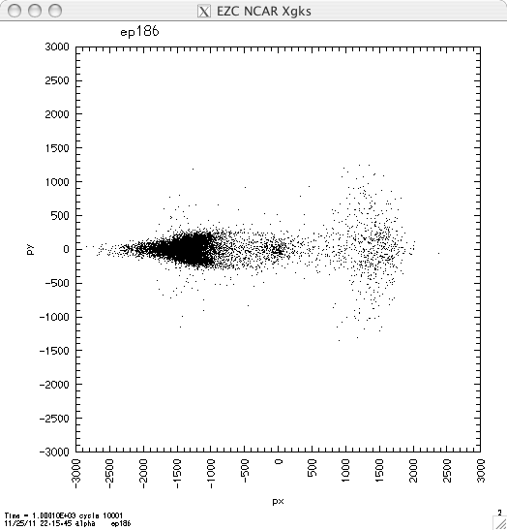
E_{y}
E_{x}
px
p_{o}=15
tω_{e}=2000
y

Slide 11
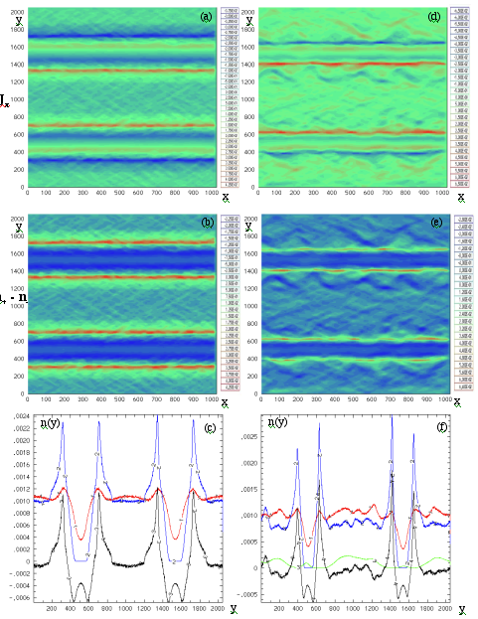
p_{o}=15mc
pure e-ion
90% e-ion 10% e+e-
tω_{e}=3000
Ion
vacuum
gap
persists
in all
cases

Slide 12
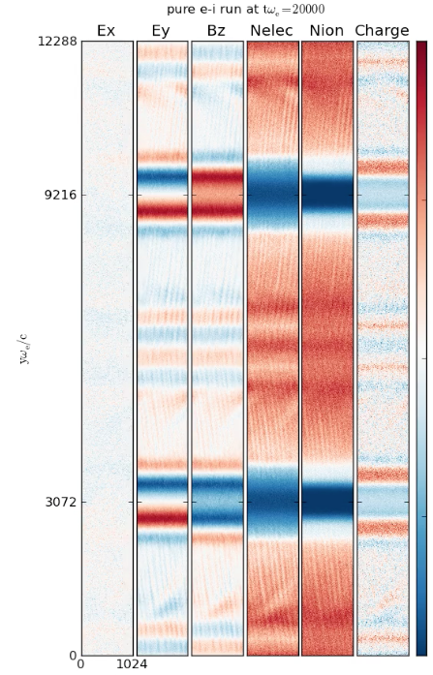
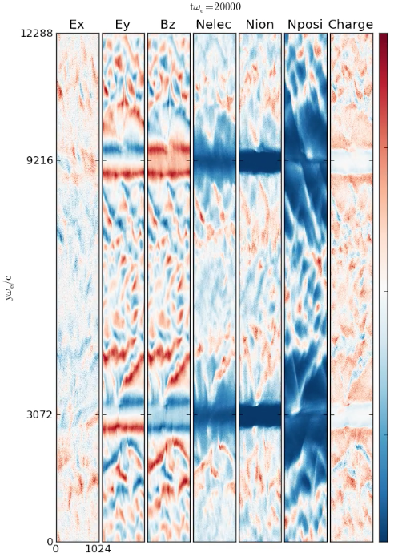
vacuum gap which separates the opposing flows remains intact
and stable for long times, sustained by strong d.c. fields
hybrid 90/10

Slide 13
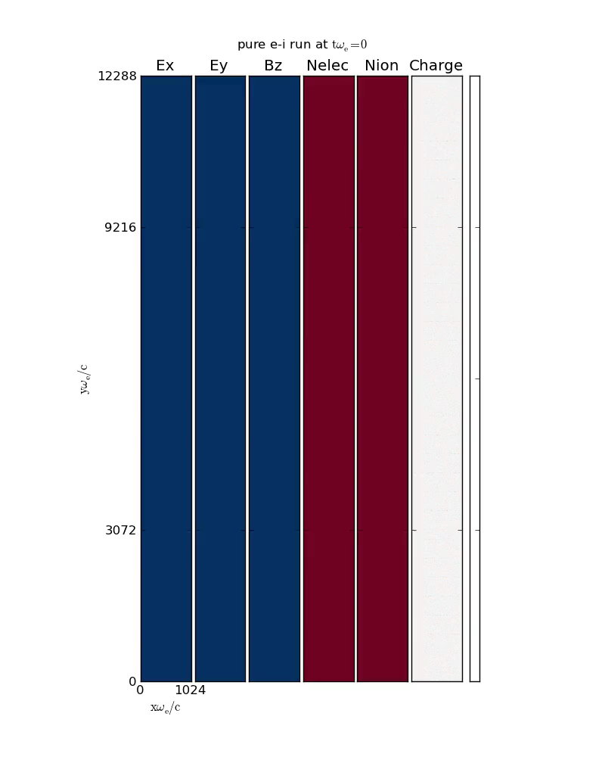

Slide 14
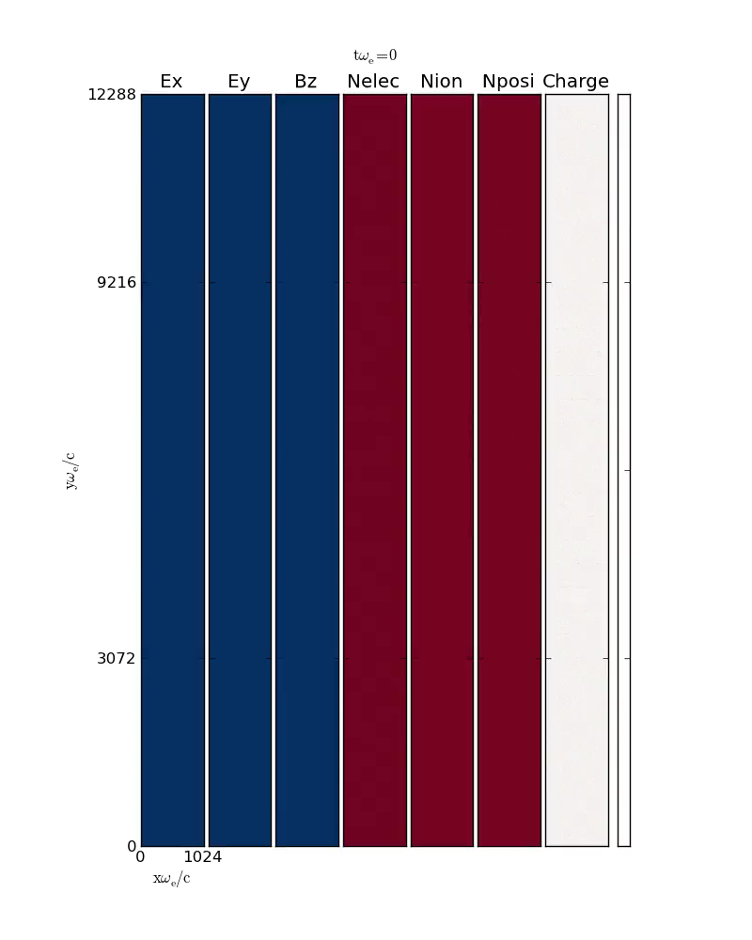

Slide 15
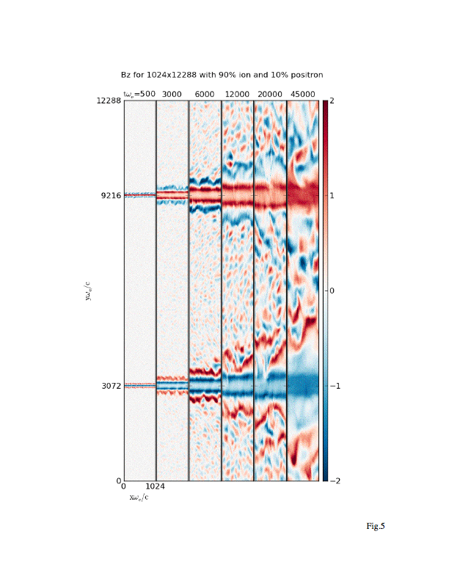
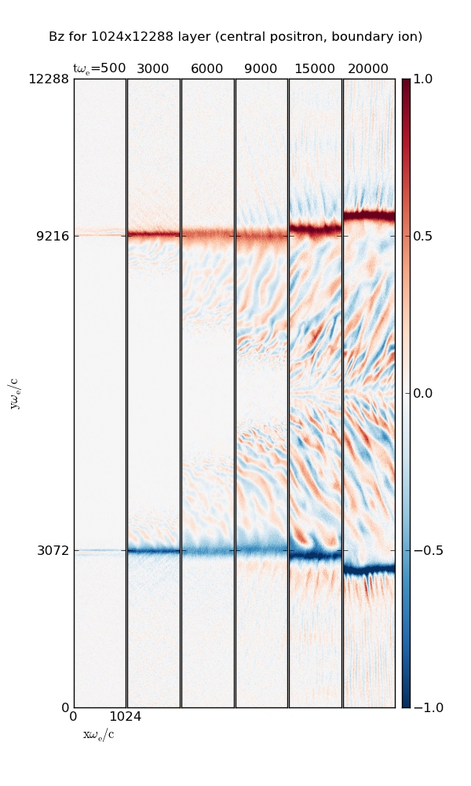
90/10 hybrid SBL thickness saturates at ~1000 skin depths but the EM turbulence
outside the SBL continues to expand into rest of flow.
Sandwiched hybrid SBL stays thin, but the EM turbulence mainly grows on the e+e-
side in the form of long narrow oblique filaments.

Slide 16
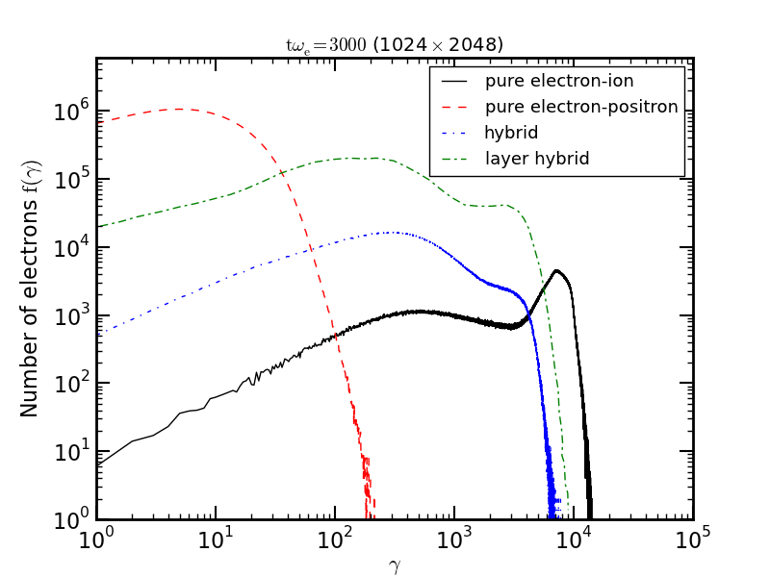
only hybrid e+e-ion shear flows develop power laws
100% e+e- produce peak energy too low to explain blazar & GRB
γ_{e}=m_{i}p_{i}/m_{e}

Slide 17
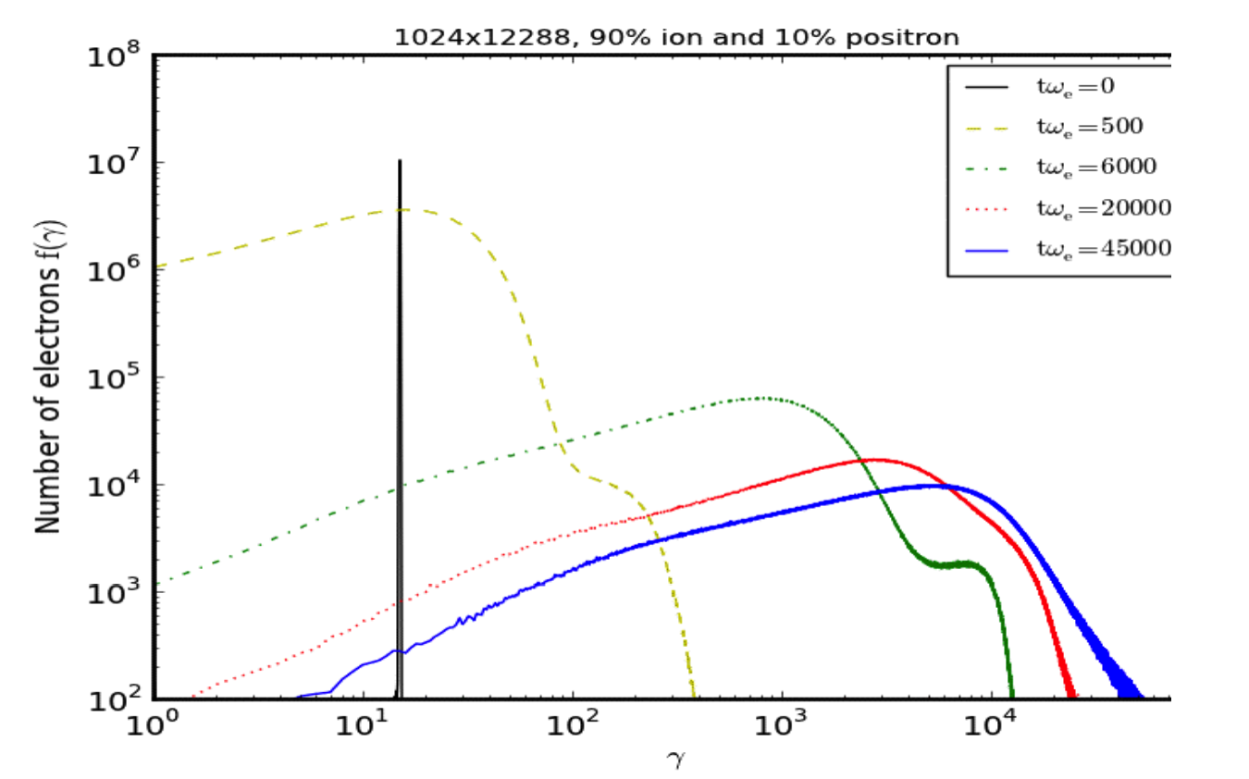
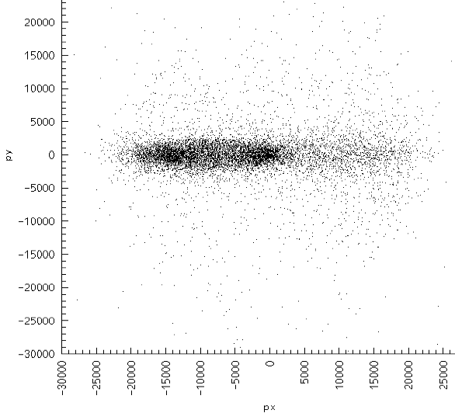
In hybrid e+e-ion case, -3 slope power law forms at late times
corresponding to emitted photon index = 2.
All runs show strong momentum anisotropy
ε_{e}~p_{i}m_{i}
-3
50GeV

Slide 18
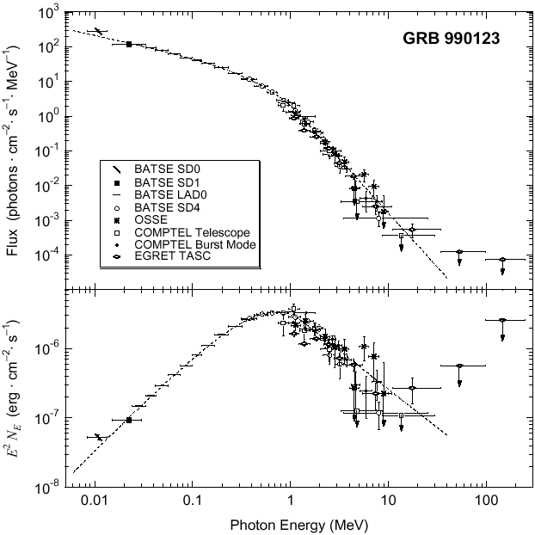
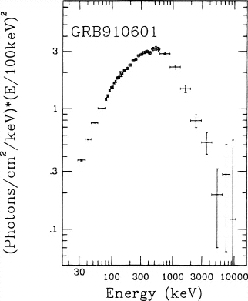
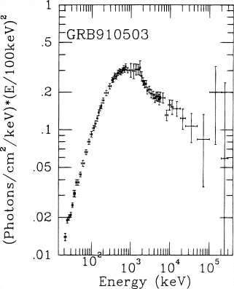
Observed Spectra of GRBs
⇑
⇑
E_{pk}
E_{pk}
Band Function
Schaefer et al. (1998)
Observed GRB spectra strongly resemble
hybrid SBL synchrotron spectra. predicted
critical frequency location is consistent with
observed E_{pk} values

Slide 19
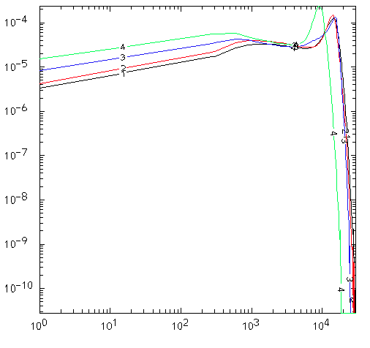
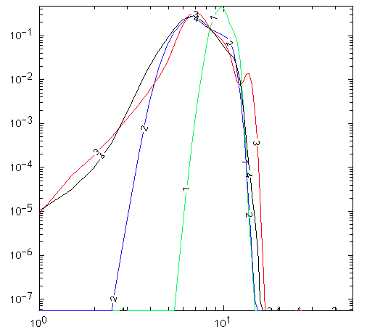
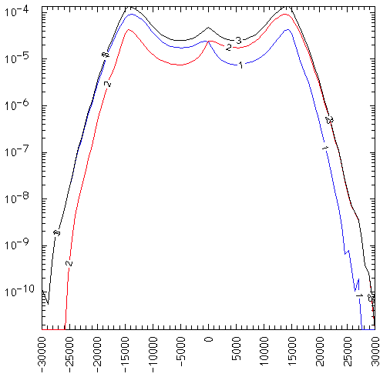
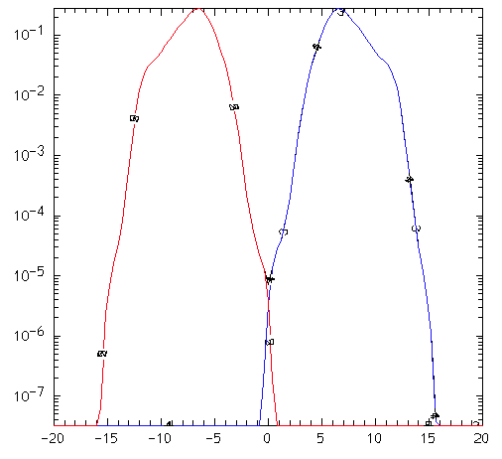
100% e-ion, Evolution of fe, fi
f_{e}(γ)
f_{i}(γ)
p_{o}=15
γ
tω_{e}=8000
f_{e}(p)
f_{i}(p)
p_{x}

Slide 20
Electrons in trapped orbits get sustained E_{x} acceleration
e -
ion
+
E
-
ion
+
E
e -

Slide 21
Extrapolate y-profiles to + / - infinity to model single SBL
Bz
Ex
y
Ey

Slide 22
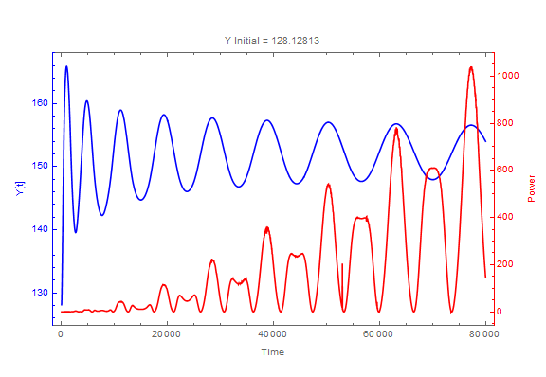
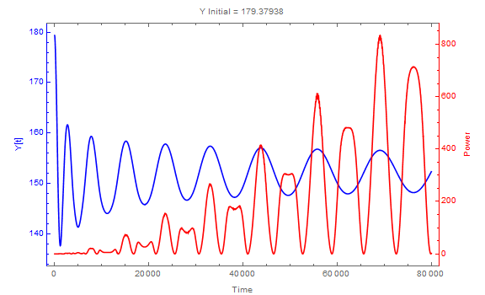
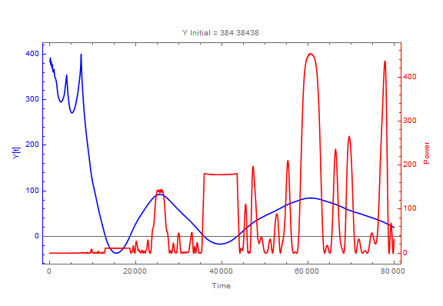
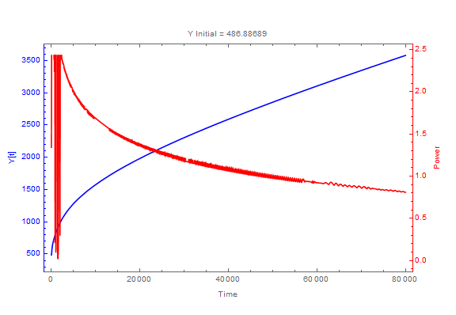
Trapped electrons radiate the most power

Slide 23
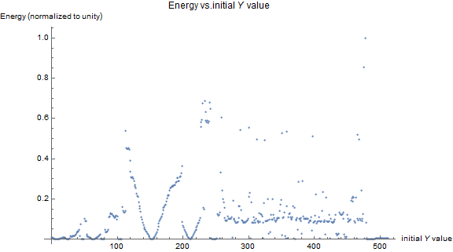
electrons initially at y=100 to 300 just outside the slab field layer
radiated the most energy

Slide 25
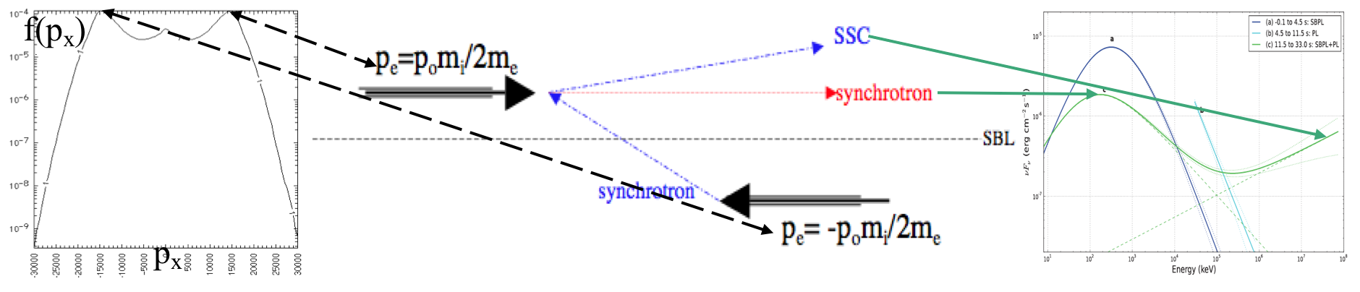
Enhanced SSC emission is expected along jet axis
due to the two opposite high-γ electron streams.
This may be important to blazar and GRB emissions

Slide 26
Summary and Conclusions
PIC simulations show efficient field creation and
nonthermal particle energization at relativistic SBL.
3. Ion-dominated SBL generate monopolar slab of d.c.
field. Ion vacuum gap created at the SBL inhibits
turbulent mixing and sustains opposing flows.
4. Electrons are energized to ~ion kinetic energy
but no power-law tail.
Hybrid e+e-ion SBL generate monopolar d.c. fields
plus EM waves. Only hybrid SBL produces nonthermal
electron spectrum with hard power-law tail out to >
10’s of GeV.
Highest energy electrons radiate wiggler-like radiation
with broad spectrum and beamed along the SBL.

Slide 27
Optically Thin Synchrotron (OTS) Model of GRB
E_{pk}~ p_{o}(ε_{pk}/m_{e}c²)²hν_{e}/(1+z), where ν_{e} = eB/2πmc
ε_{pk}~p_{o}m_{i}c²f/2, f=ion fraction.
For example:
If Γ =2p_{o}²= 450, f = 0.9, z = 1 and
E_{pk} = 250 keV (Preece et al 2000), we obtain
B (in the CM frame) ~2x10⁴ G.
Using B²/4πp_{o}nm_{i}c²~8%, we obtain ion (~electron)
density n (in the CM frame) ~10¹⁰/cm³.
These are ~consistent with current observational constraints.

Slide 28
The highest energy particles oscillate with increasing
period and decreasing amplitude along the shear boundary.
They radiate wiggler-like radiation with highest intensity
emitted at the turning points. Radiation is broad beam along
the flow direction. The critical frequency is determined
by the bounce period

